Slide 1

Using MLflow and Prefect for
Experiment Tracking and Model Management
for Sentiment Analysis Project
By :
Madhavi N
(Intern ID – IN1241092)

Slide 2




About me :
Background ? (B-tech or M-tech) : Madhavi ( BSc(COMPUTERS)), Data Science Course
Why you want to learn Data Science : For FUTURE GROWTH, To get better CAREER OPPORTUNITIES
Any work experience : Fresher
Share your LinkedIn and GitHub profile URLs :
Note : Links are available in hyperlink to above logos

Slide 3


Project analysis slide 3
Project Details
Task steps :
Objective
Integrate MLflow into your existing machine learning projects.
Train machine learning models while logging relevant information with MLflow.
Demonstrate how to log parameters, metrics, and artifacts using MLflow tracking APIs.
Customizing MLflow UI with run names.
Demonstrate metric plots.
Demonstrate hyperparameter.
Demonstrate how to register models and manage by tagging them.
Bonus
The objective of this task is to introduce you to MLflow for experiment tracking, model management, and reproducibility in machine learning projects for the Sentiment Analysis Project.
Build a Prefect Workflow and Auto Schedule it.
Show the Prefect Dashboard with relevant outputs.

Slide 4











Project analysis slide 2
MLflow Project Steps
LOADING THE DATA
MODEL BUILDING & EVALUATION
IDENTIFYING INPUT AND OUTPUT
IMPORT MLFLOW
TRAIN AND TEST SPLITTING
SET THE TRACKER AND EXPERIMENT
DATA PRE-PROCESSING
START A EXPERIMENT RUN
FEATURE EXTRACTION
MODEL REGISTRY

Slide 5
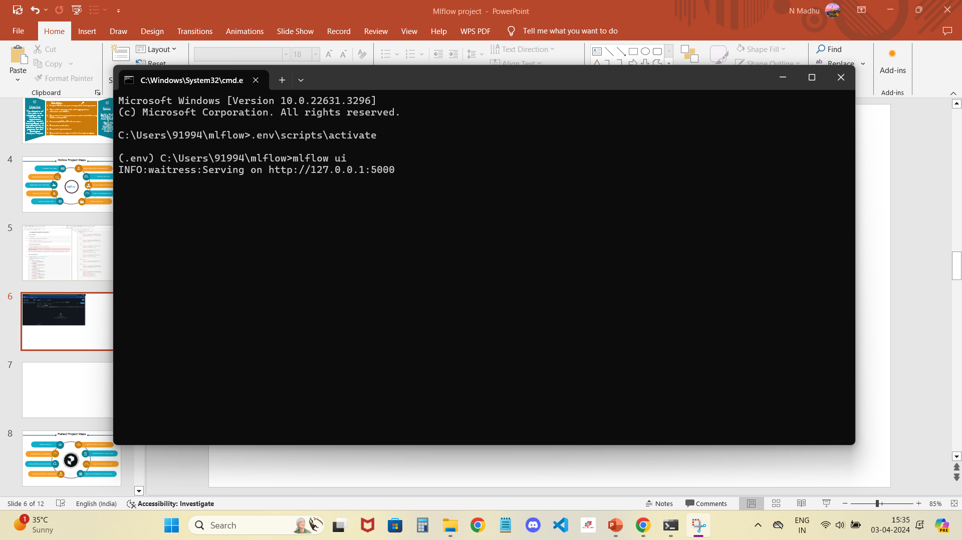
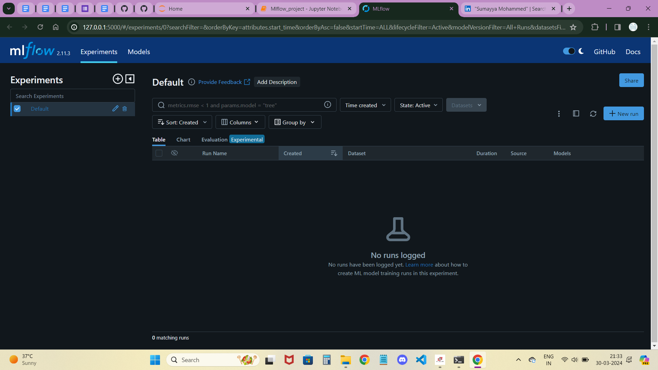
mlflow Dashboard
First, open command prompt at required folder which has the code of MLflow.
Then, install MLflow using $ pip install mlflow
Next, to open the MLflow Dashboard use $ mlflow ui
You can see this below Dashboard of MLflow with the 2 different parts which we use Experiments and Models.
The code snippet is essential for Integrating MLflow into our workflow, facilitating efficient management of machine learning tasks.
Key Features :
Experiment Tracking
Model Management
Deployment

Slide 6
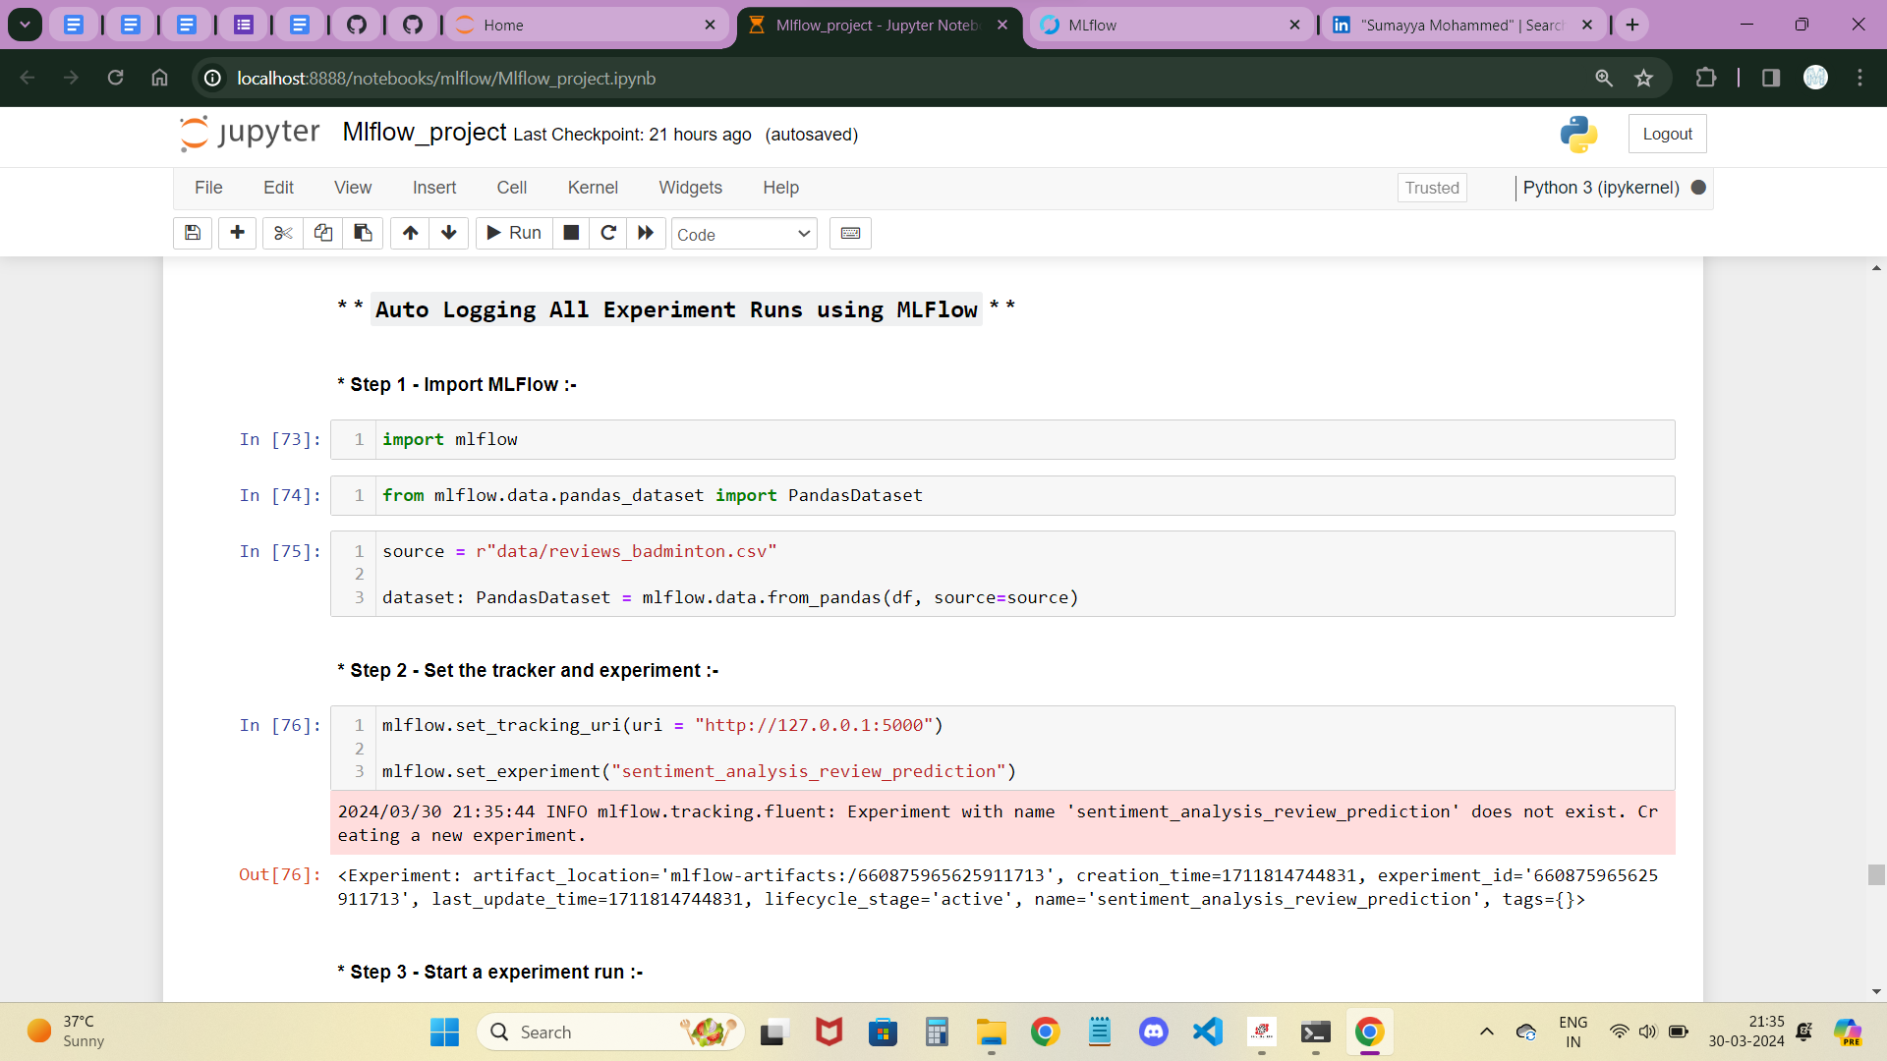
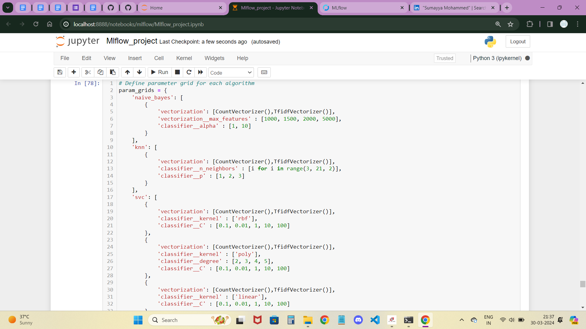
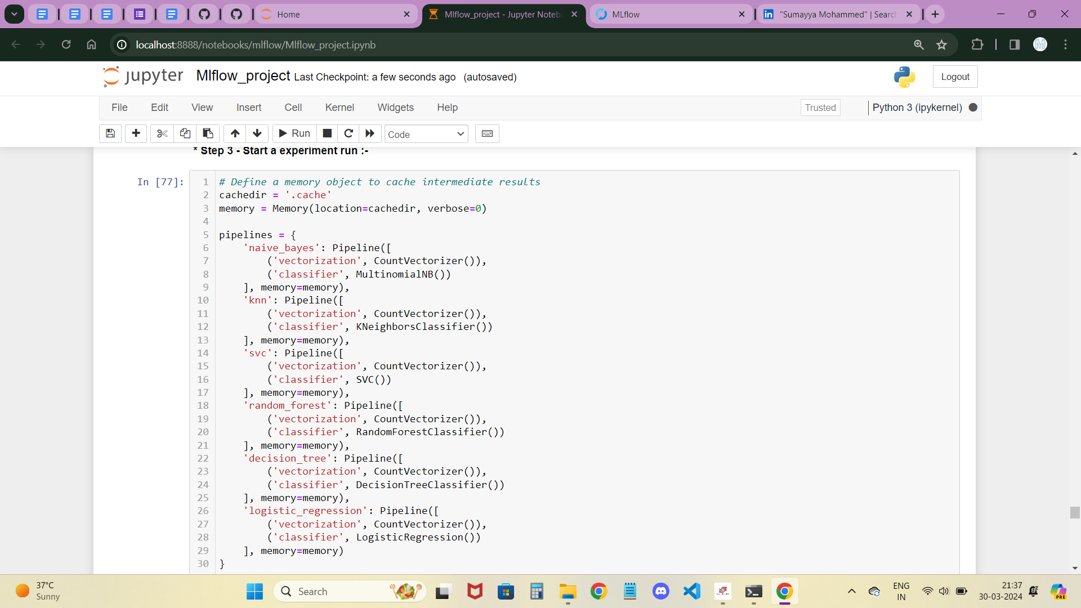
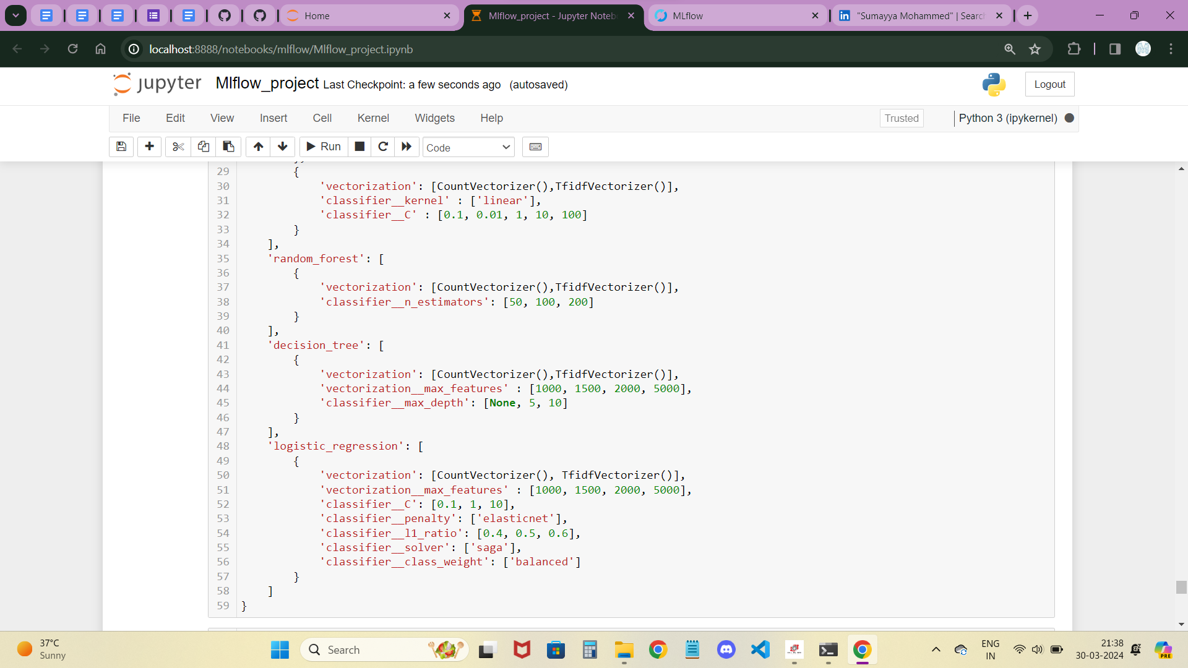

Slide 7
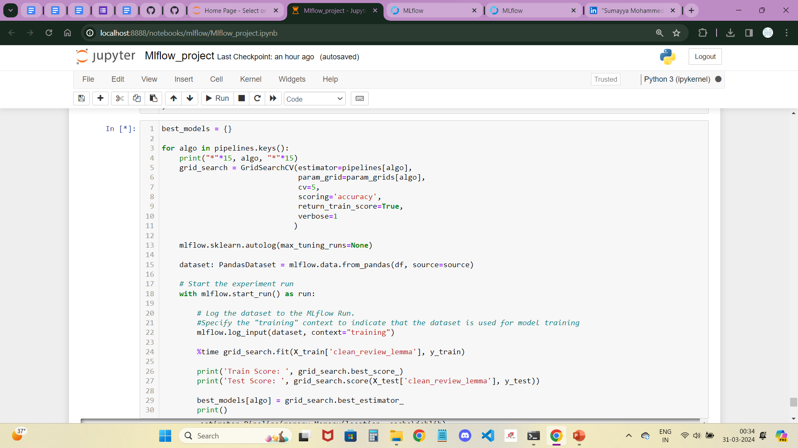
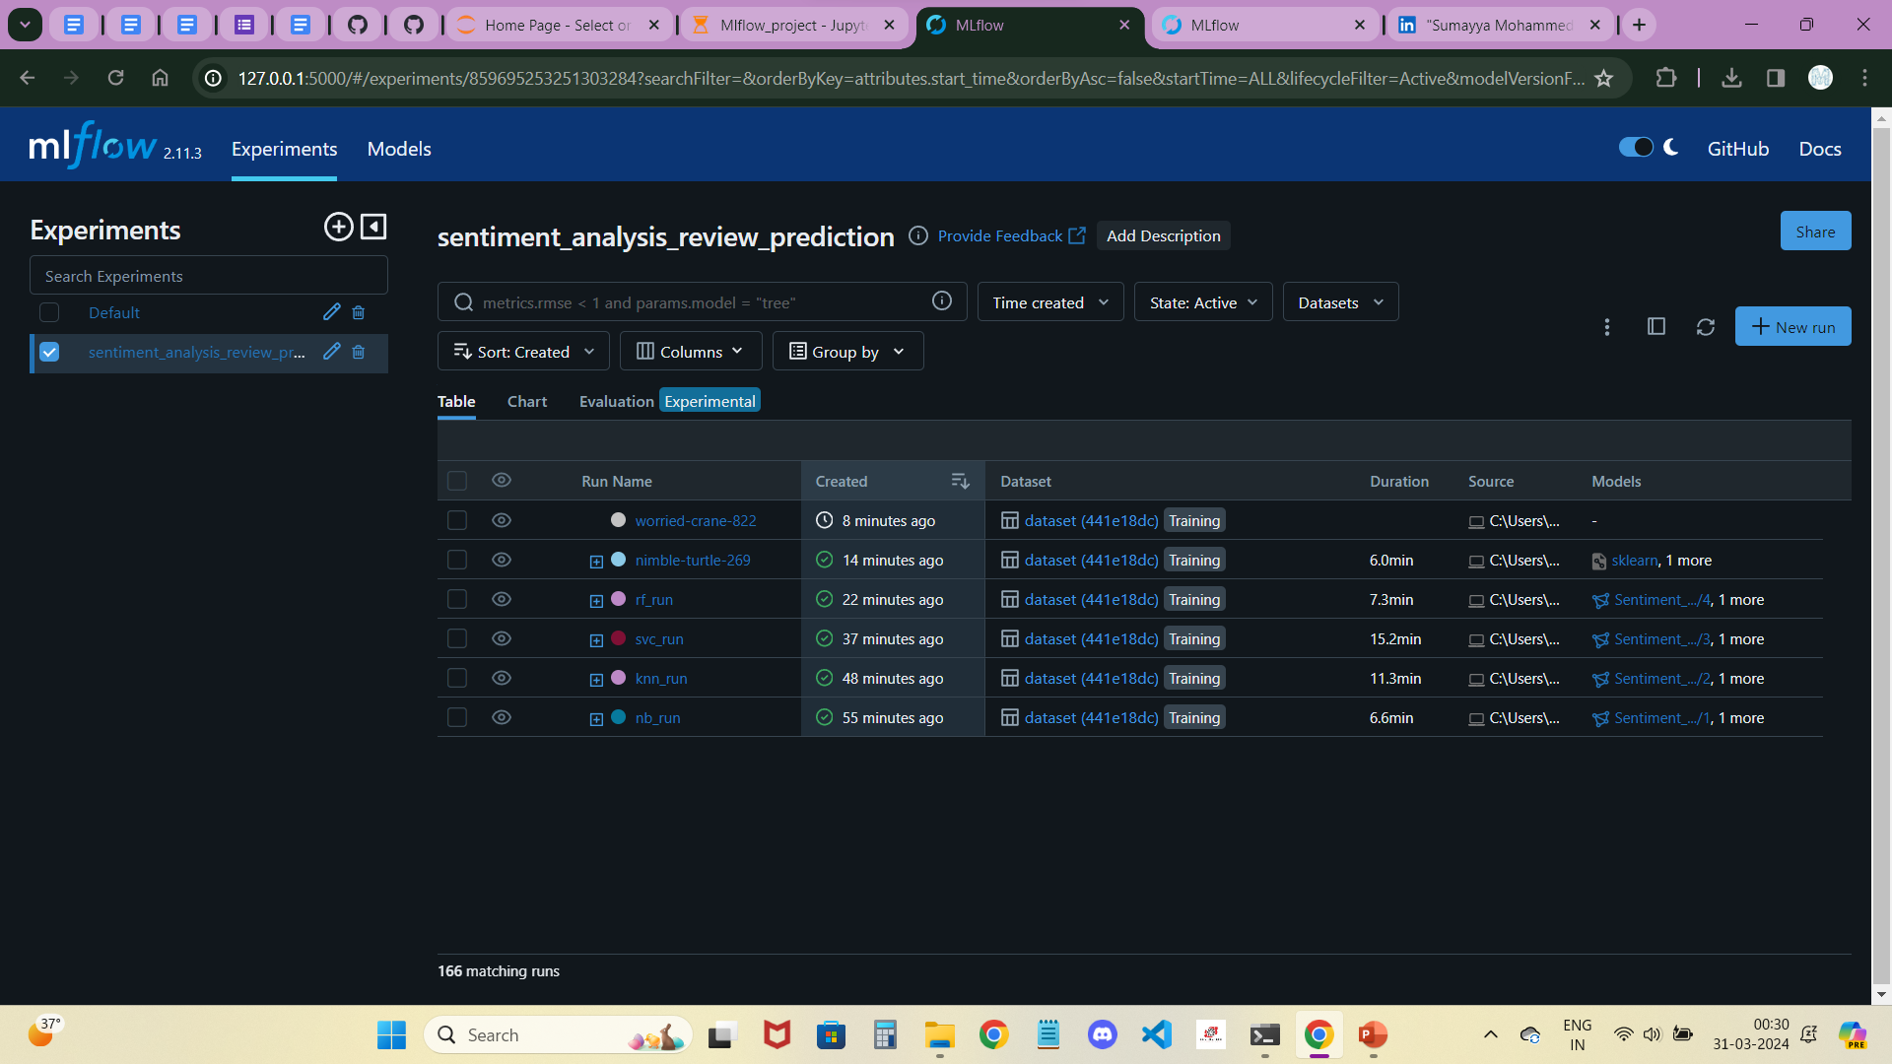
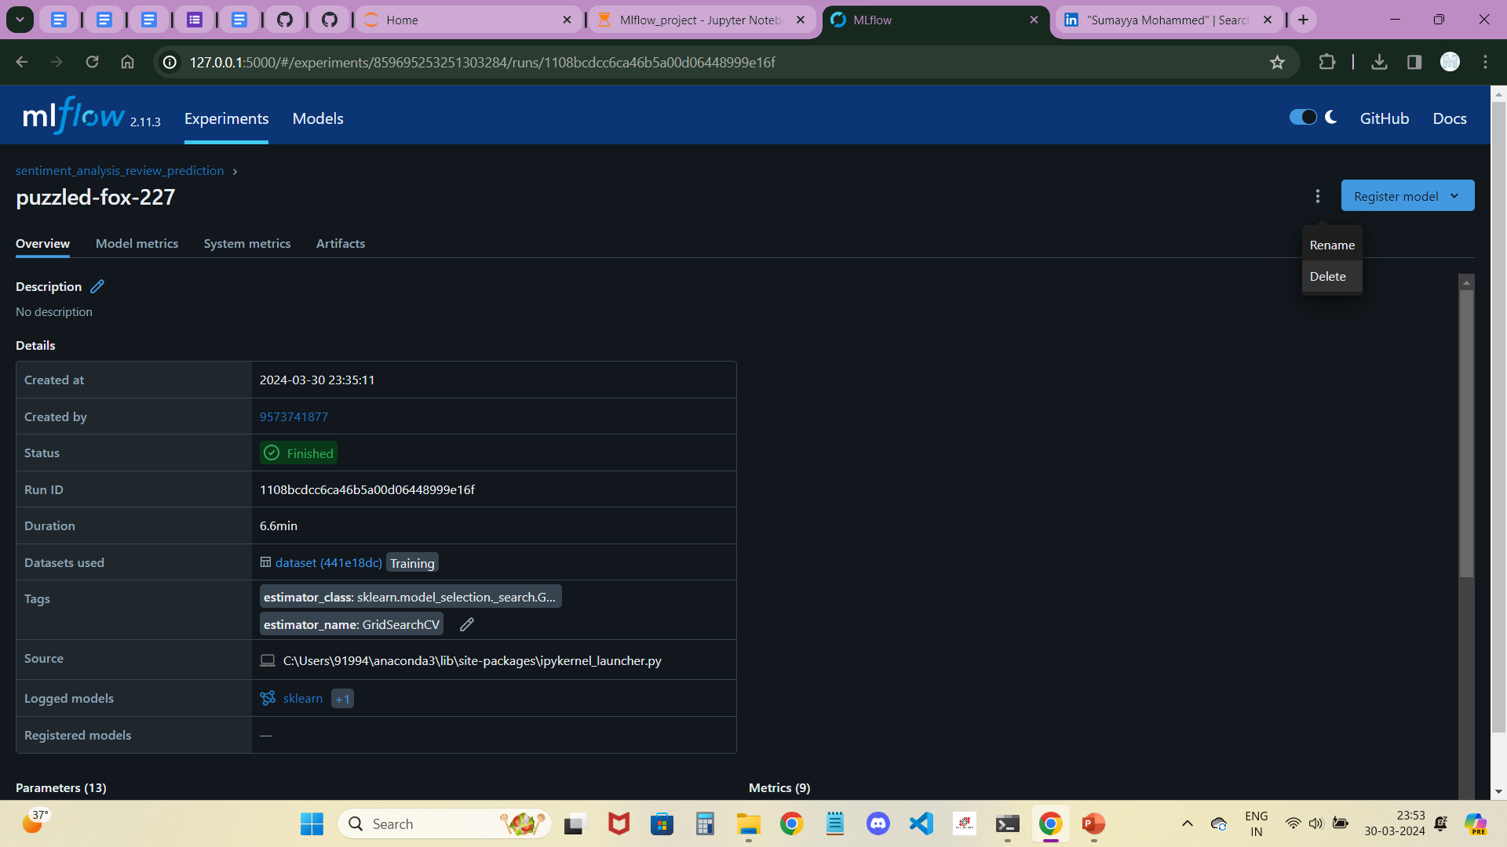
After running this all above code in Jupyter notebook, check mlflow tab to see the created experiment is displayed below default.
We can get the runs which are loading and running at right side.
Click on that run name, we can get this just like left side image.
Click in that 3 dots at right-above to get rename option.
We can change name to related model name with run whatever we like to understand from which model it came.

Slide 8
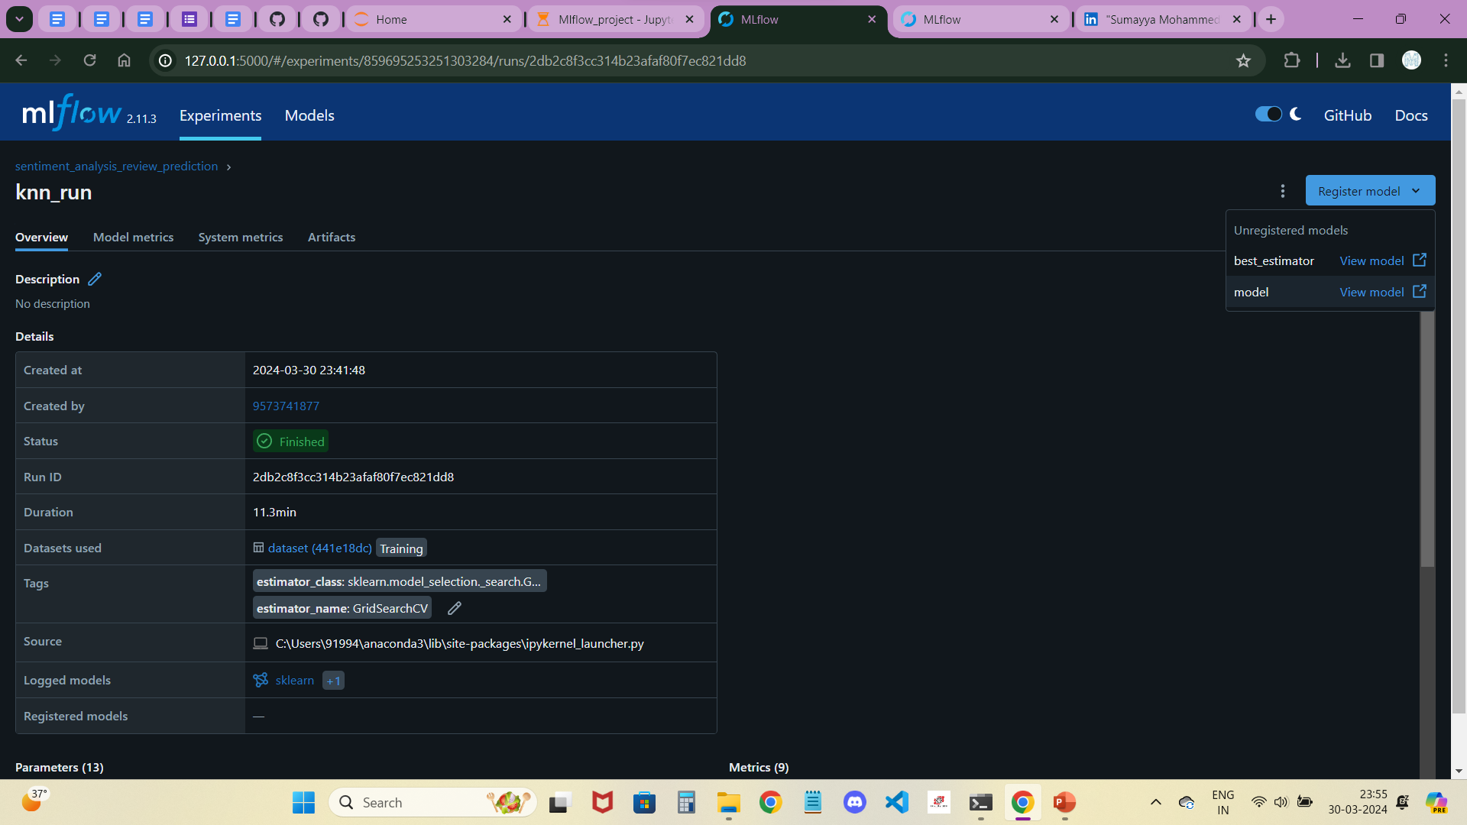
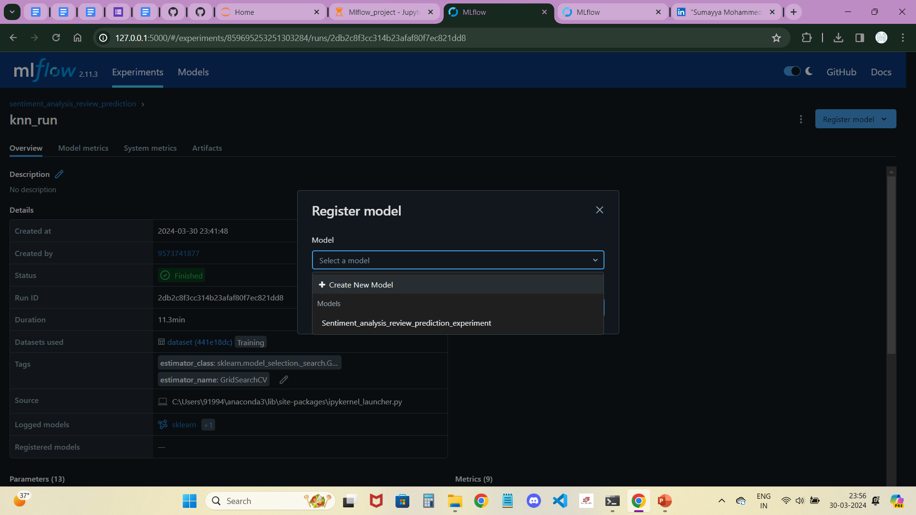
Then, click on Register model to create a new model for using it.
Next, we can see the pop-up tab which is just like right-side image.
Click on create new model for the first time when we create and use it for other runs of this same mlflow code.

Slide 9
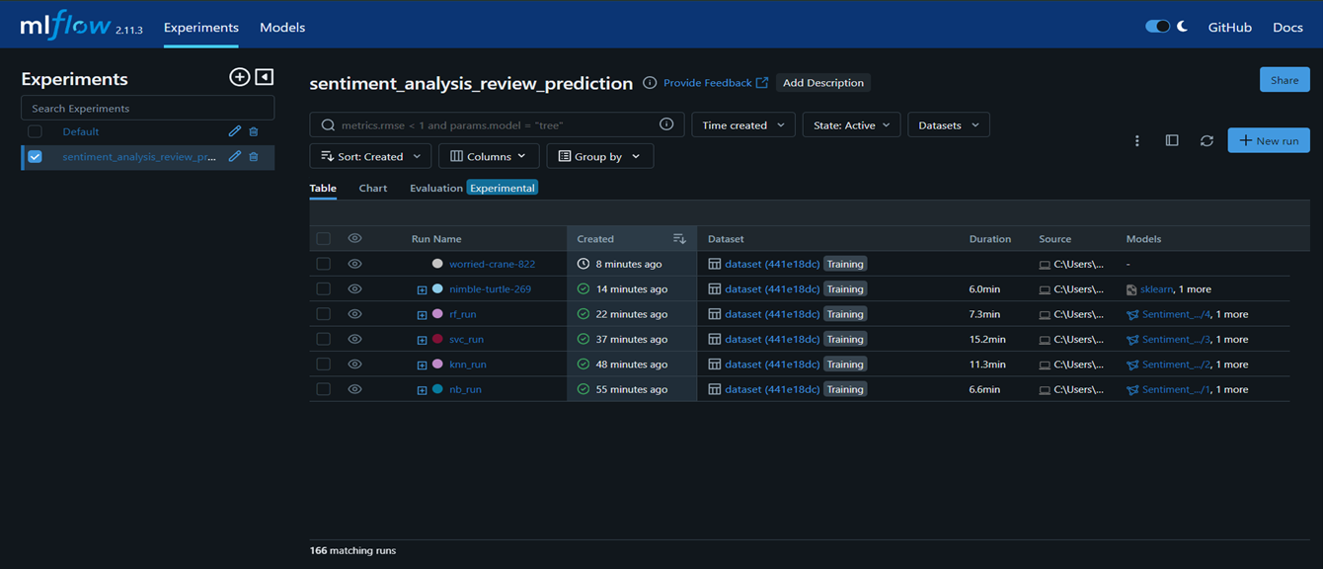
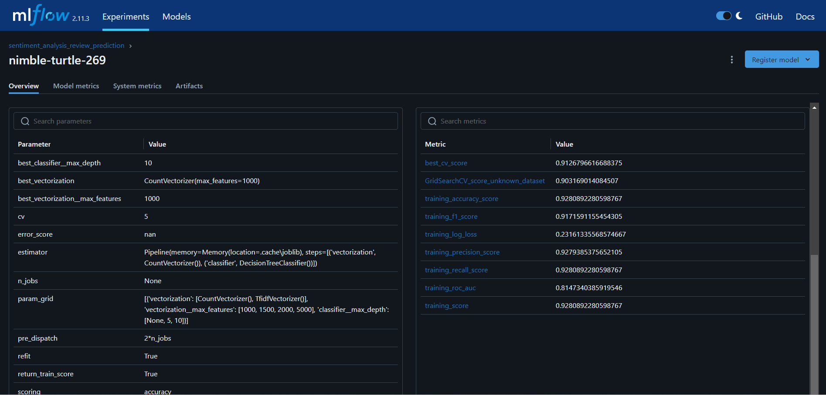
After registering for what runs we want, we can get different icons which are added to registered model and which or not.
We can get them in the form of versions which we register to the created model i.e., version 1, version 2 and so on.
After registering the wanted runs into created model, select which run duration is less as well as better performance.
After selecting the run, click on it to check what are the best hyperparameters as well as vector (or scalar ) from the given set which we used it Machine Learning Pipeline to Automate the Workflow for our Sentiment Analysis for Flipkart Reviews Task.
It also shows model scores, aiding performance evaluation.
To identify the appropriate values of each model's parameters, select the 'Columns' option within the MLflow dashboard

Slide 10
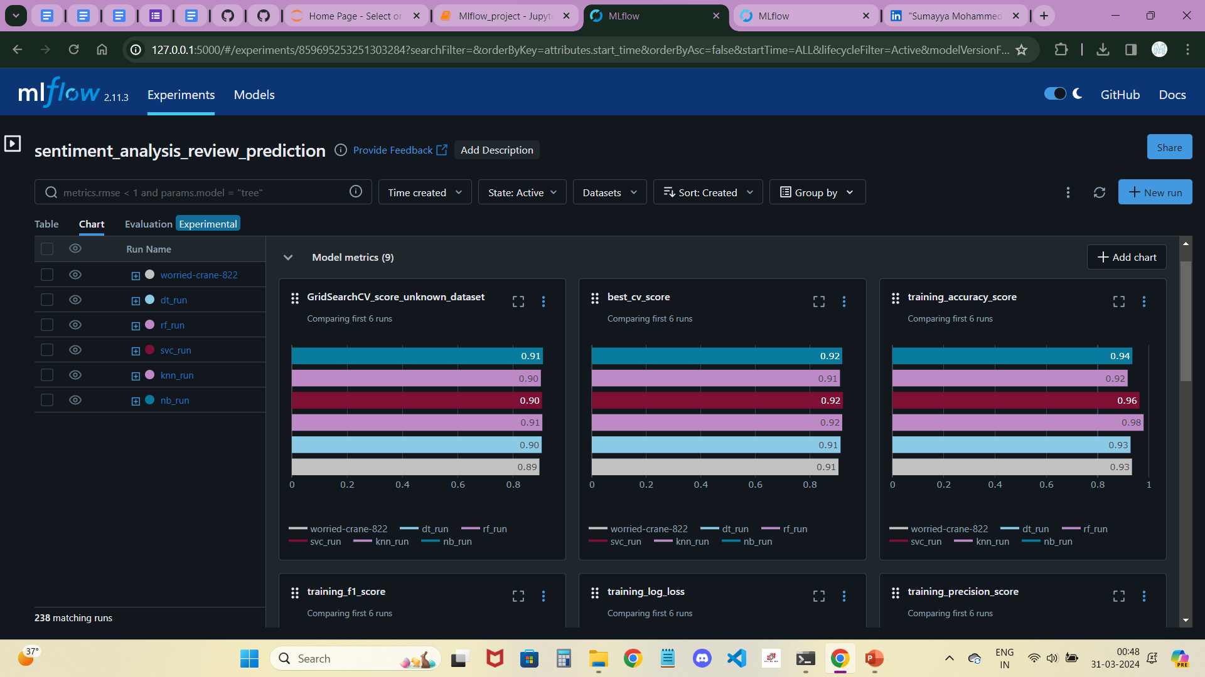
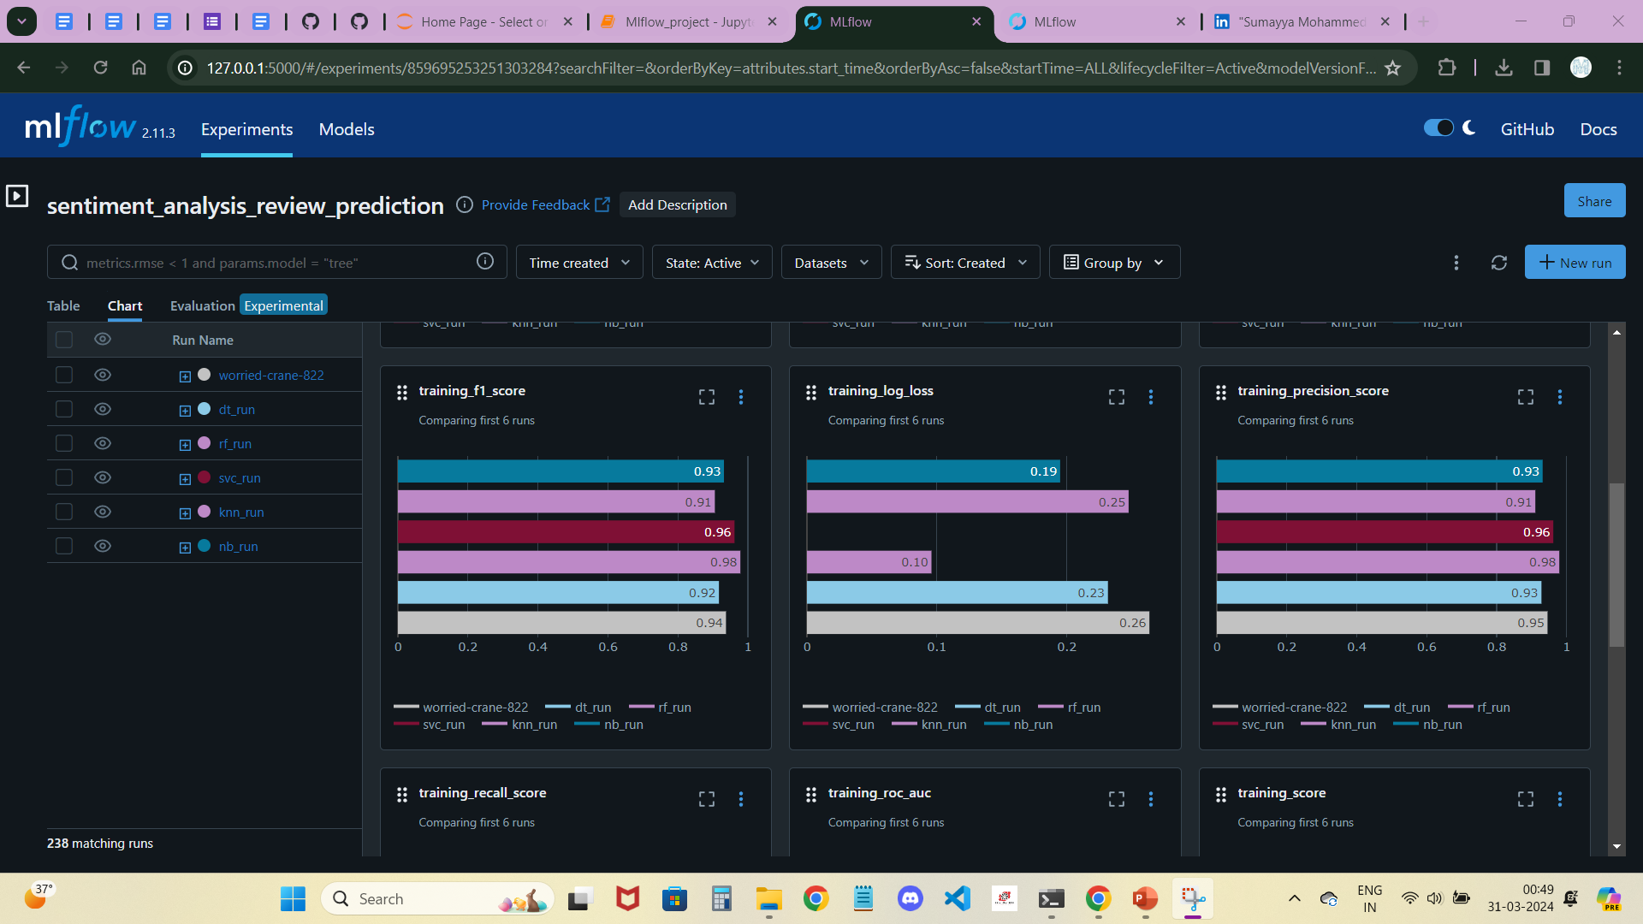
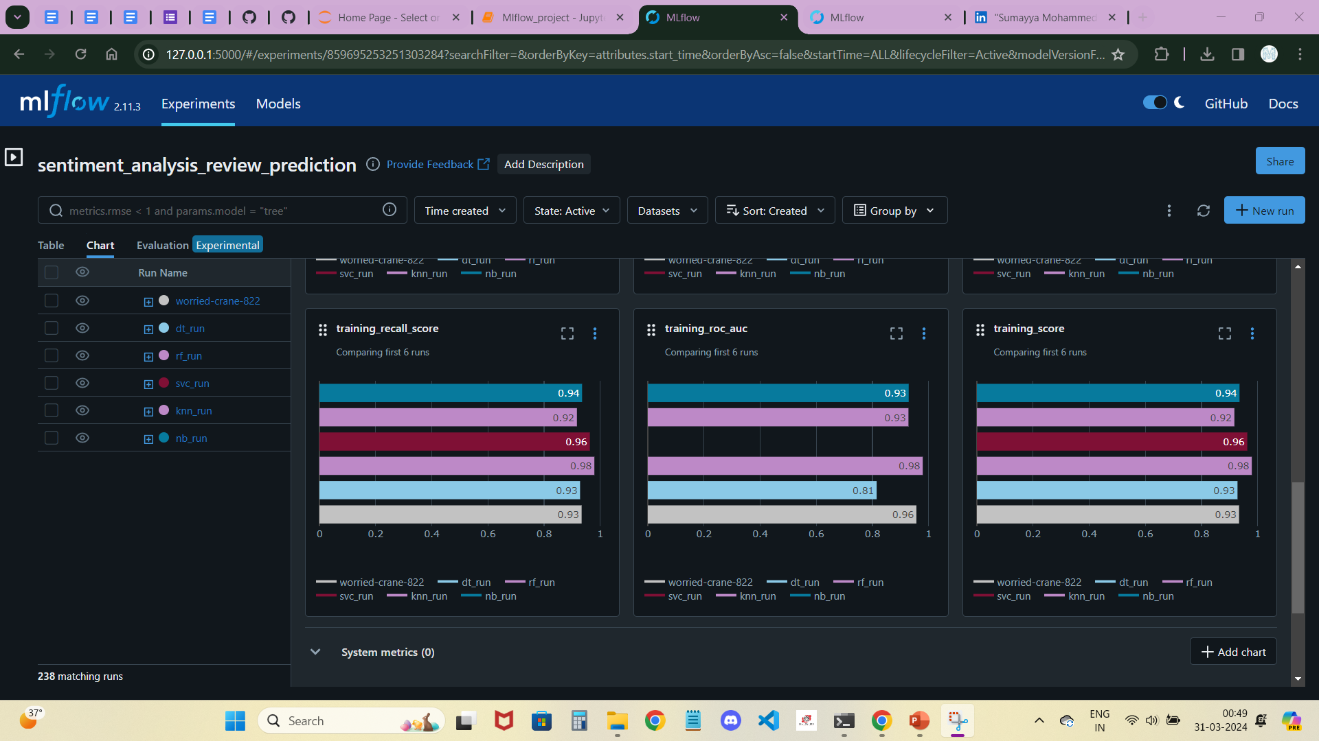
Demonstration of Metric plots:
We can see this all different scores in the column option in the MLflow Dashboard.
To access metric plots, click on the 'Charts' option in the MLflow dashboard.
Mlflow provides default metric plots, but we can also create custom plots for further analysis and visualization

Slide 11
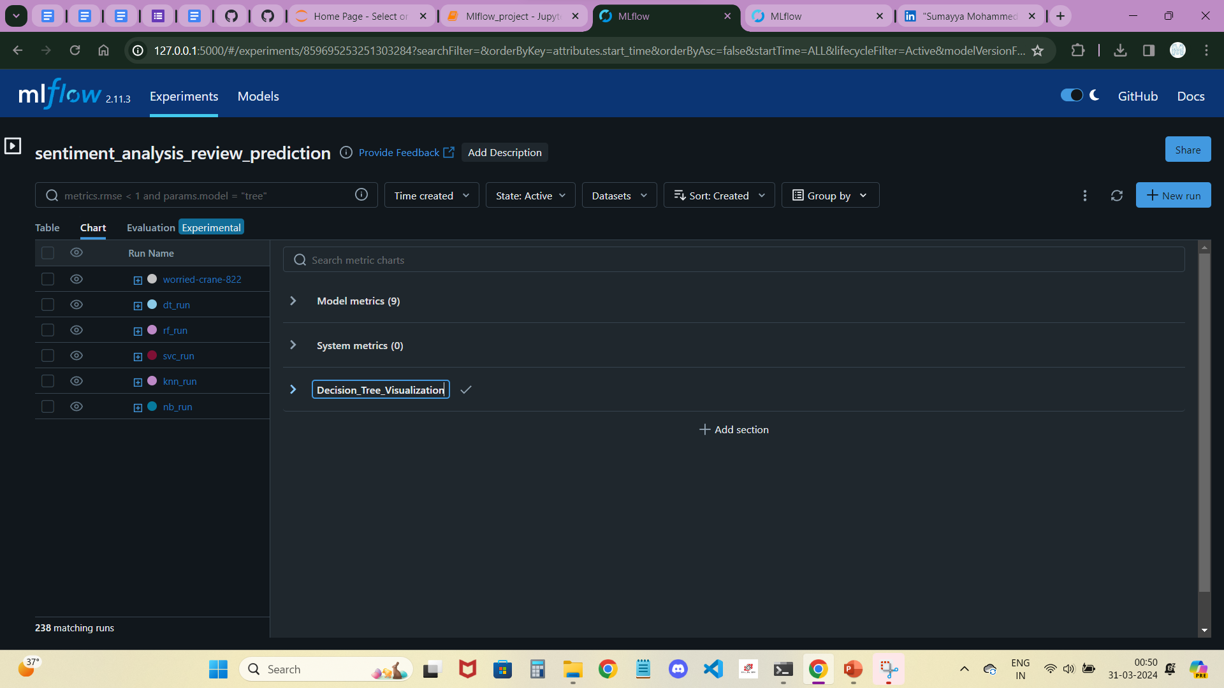
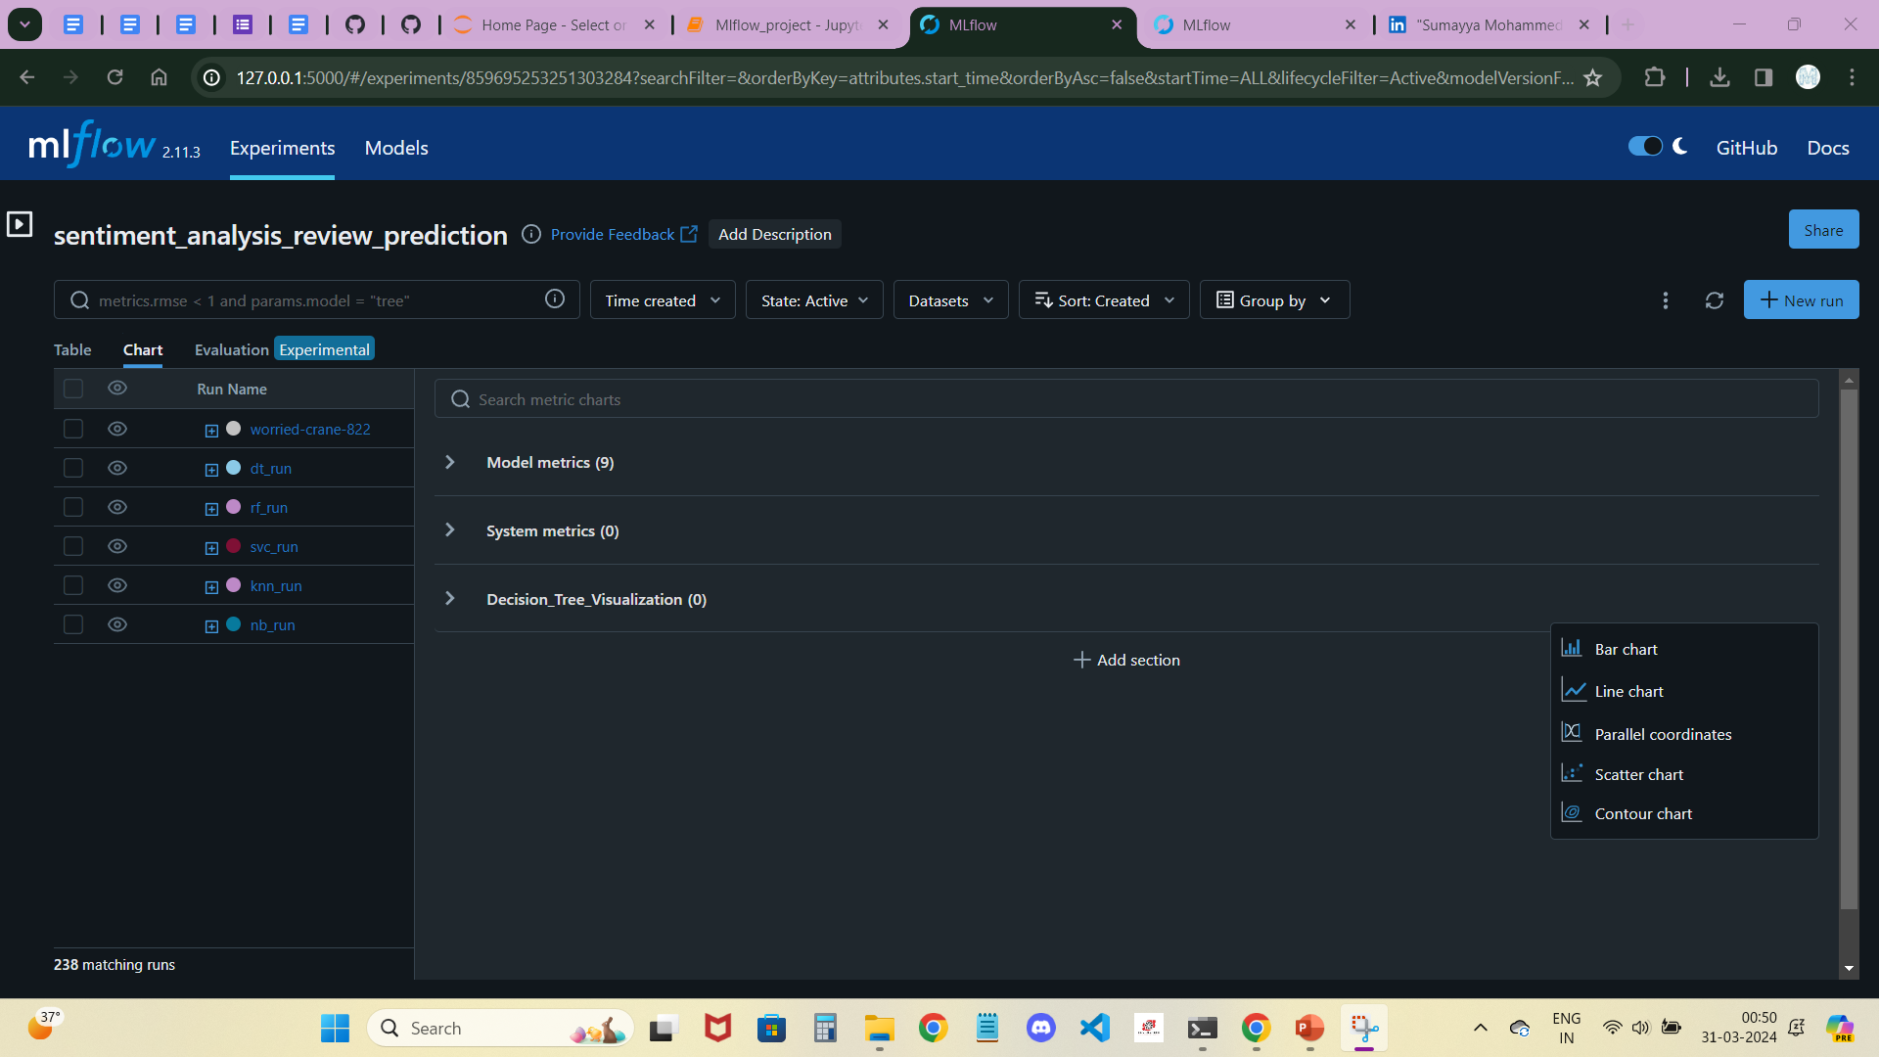
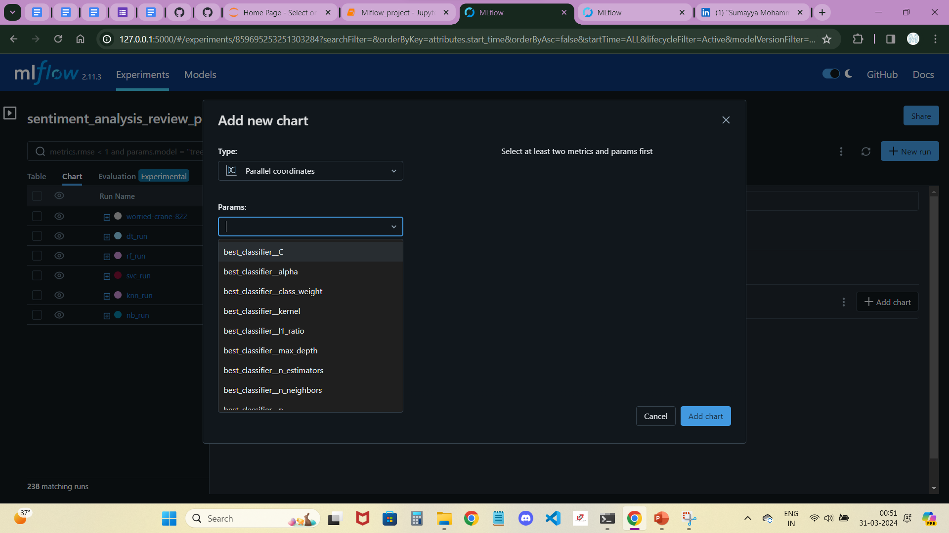
Demonstration of Hyperparameter's plots:
We can plot Hyperparameters by clicking on Add new section at chart of MLflow Dashboard.
Name the relevant name from run which we are using and select “Parallel coordinates” from chart options.
And, select hyperparameters which we get to know are best from overview of the model.
And, click on add chart to create the chart for specific run.

Slide 12
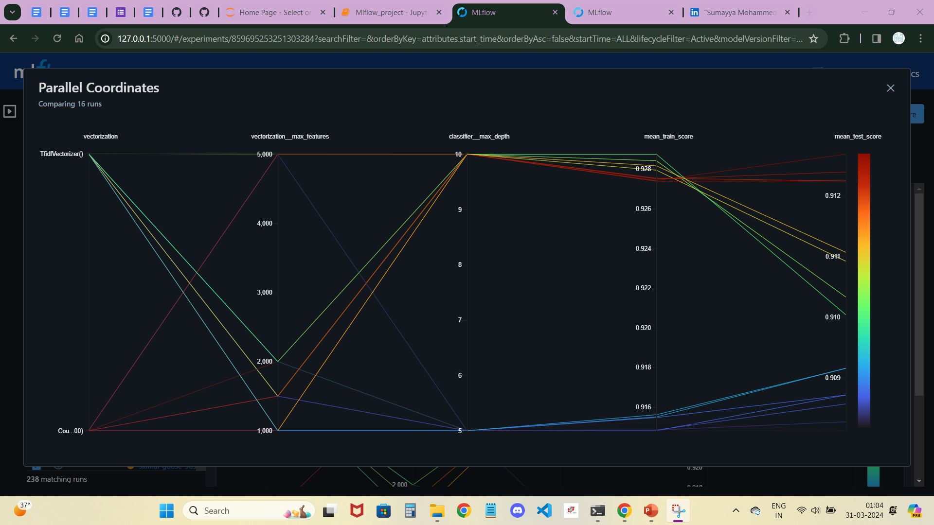
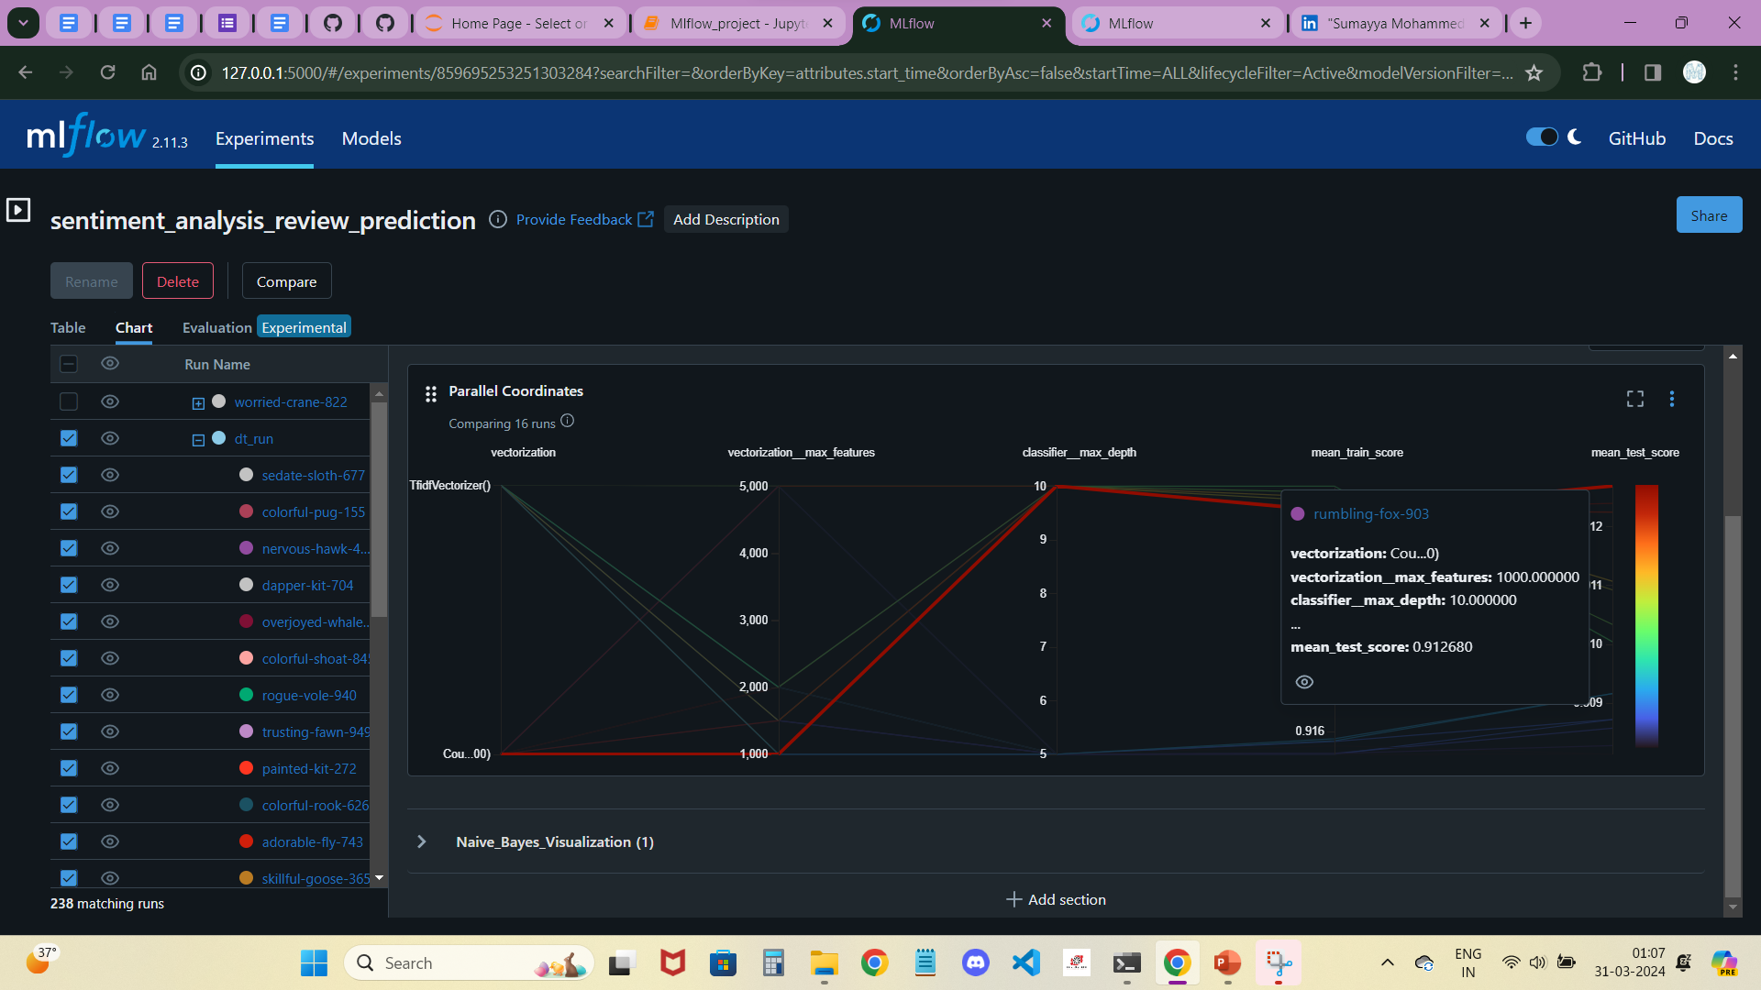
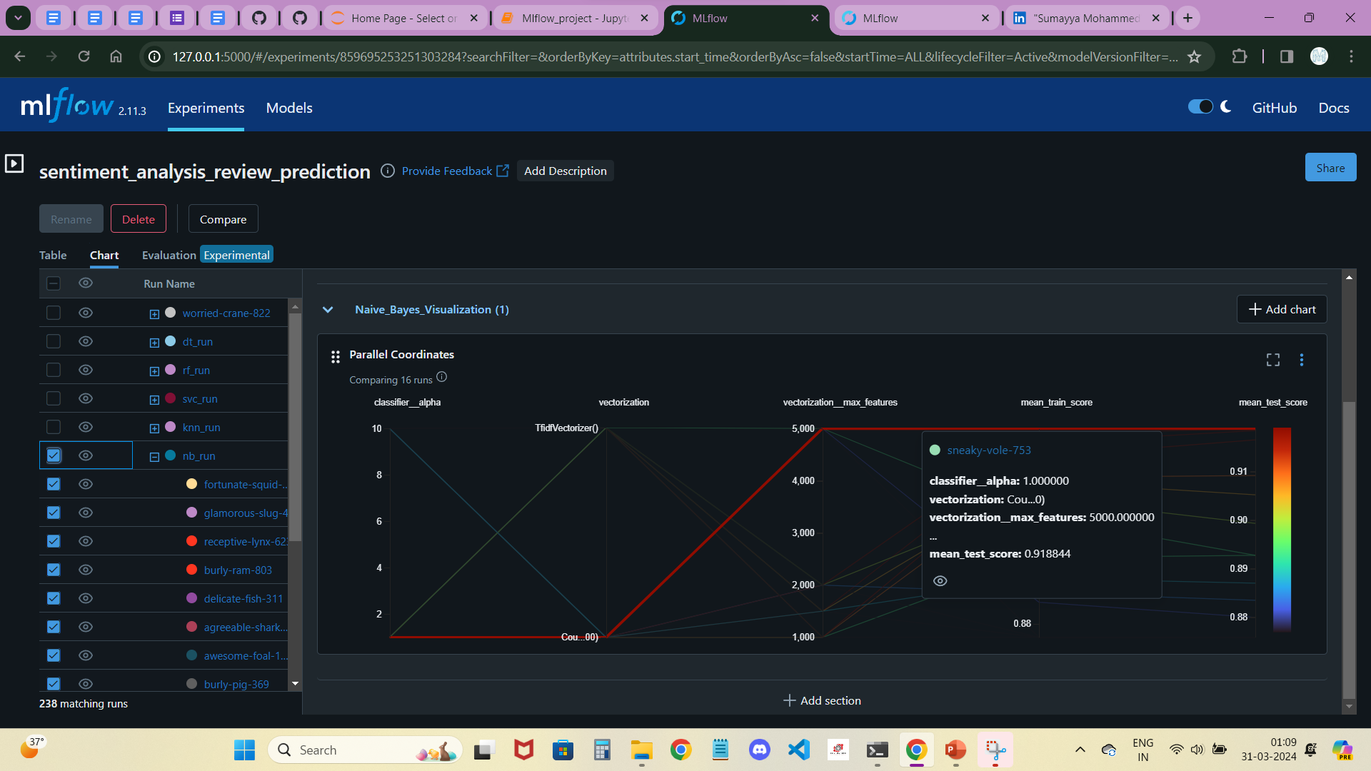
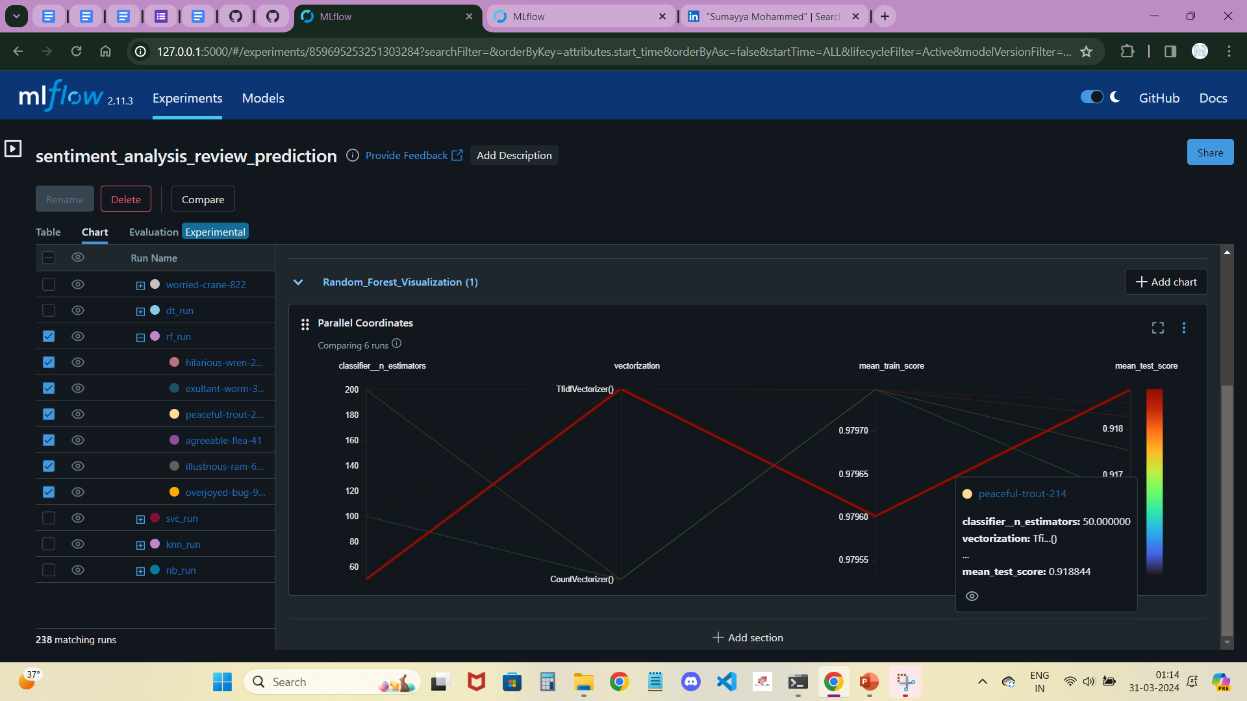
It will show like this, when we click on specific run to check the parallel coordinates chart with Hyperparameters.
We can check the train and test scores for which fit has highest.
We can see the hyperparameters as well as vector which we used for vectorization ( or scalar for rescaling ) with mean train and test scores.
We can check which fit has highest test score when we put the curser on that line.
Where, we can see which specific hyperparameters and vector are useful for best fit of a model from the run.
These 3 images, which has the specified run with less duration and the highlighted line was the best fit for each run.

Slide 13
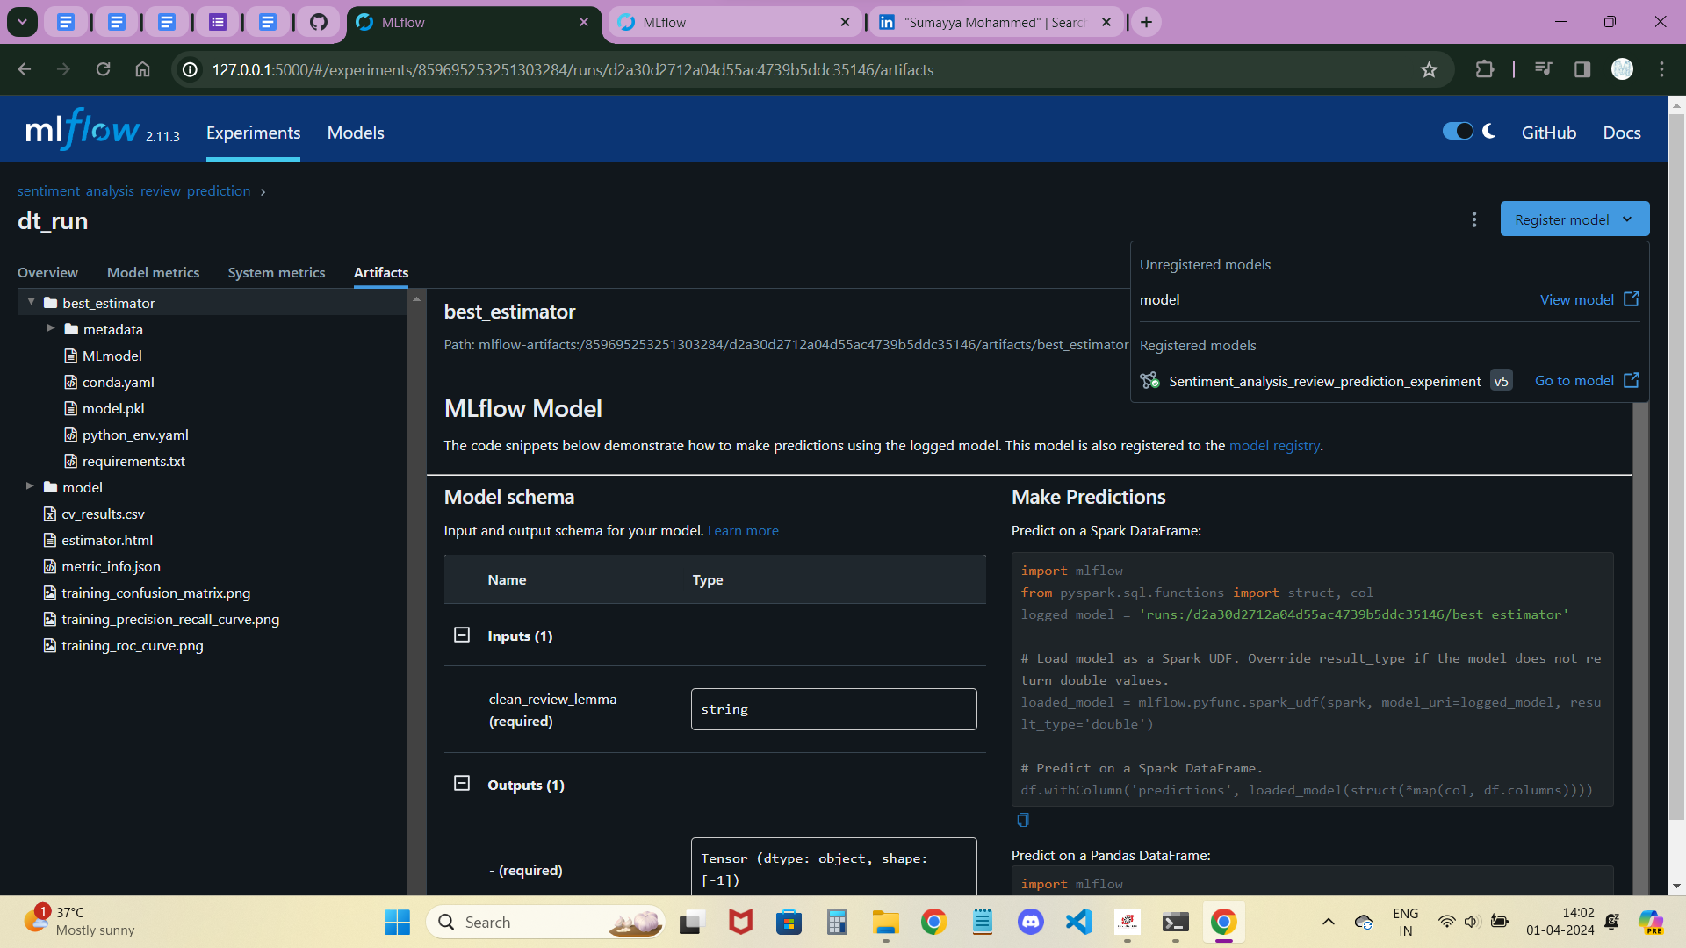
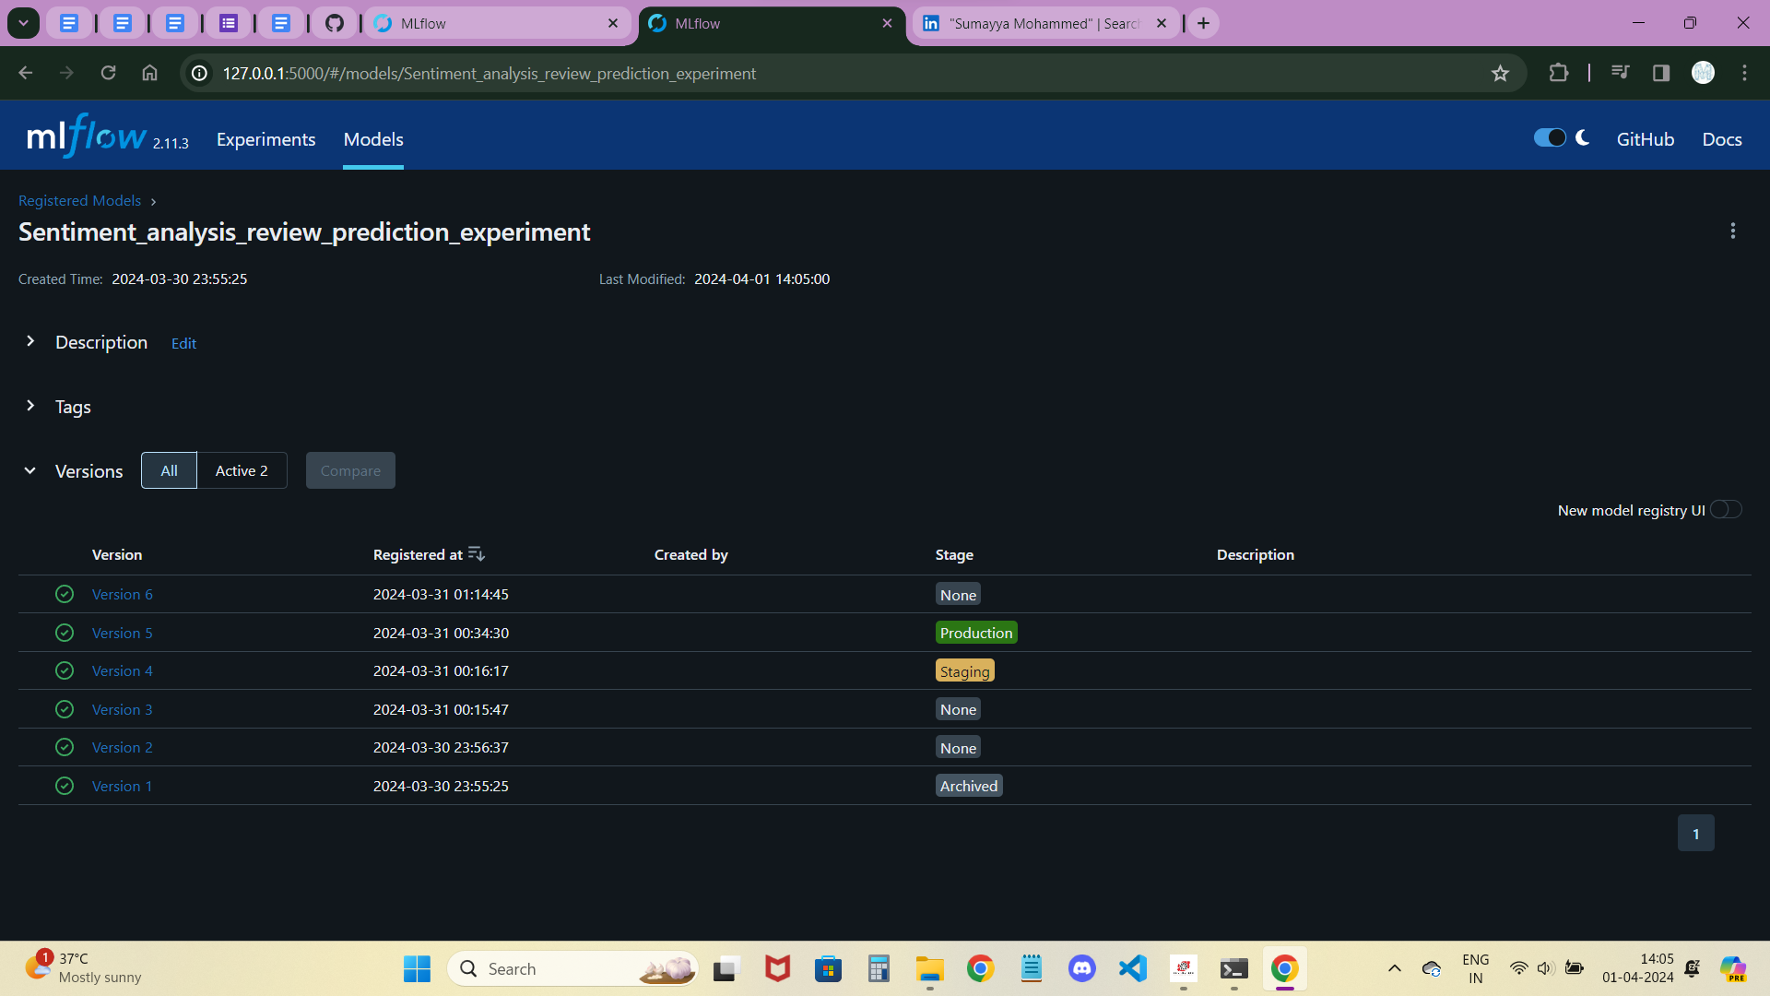
After that, click on the best run from the runs which we registered with the model we create and click on Artifacts for to see about best-estimator and model.
Then, click on the Register model button at right-top side to click on the already registered model.
Next click on Models part, which has the created registered model, which we can see the latest version we created.
If we click on that model, we can see the created versions when we created the model registry.
In this page, we have stages for the versions with 3 different types. i.e., Production, Archived and Staging.
When we put any version into production, we can see that stage of that version will become production, if we want to use another version for production that previous version which was in production will go to Archived stage.

Slide 14

Conclusion :
When comparing tree models (Decision Tree and Random Forest) with Naive Bayes, all three models exhibit good train and test scores. However, for the production stage, it's crucial to consider not just performance but also computational efficiency. In this case, Decision Tree stands out as the model that has run in less time during training and inference, making it a suitable choice for the production stage. Its efficient computation can lead to faster deployment and real-time inference, ensuring optimal performance in production environments.

Slide 15





Project analysis slide 2
Prefect Project Steps
INSTALL PREFECT
IMPORT PREFECT MODULES
RUNNING PREFECT DASHBOARD
DEFINE PREFECT TASK, FLOW
REFACTORING ML WORKFLOW
START A EXPERIMENT RUN
BUILDING A PREFECT WORKFLOW
MAKE THE WORKFLOW SCHEDULABLE

Slide 16
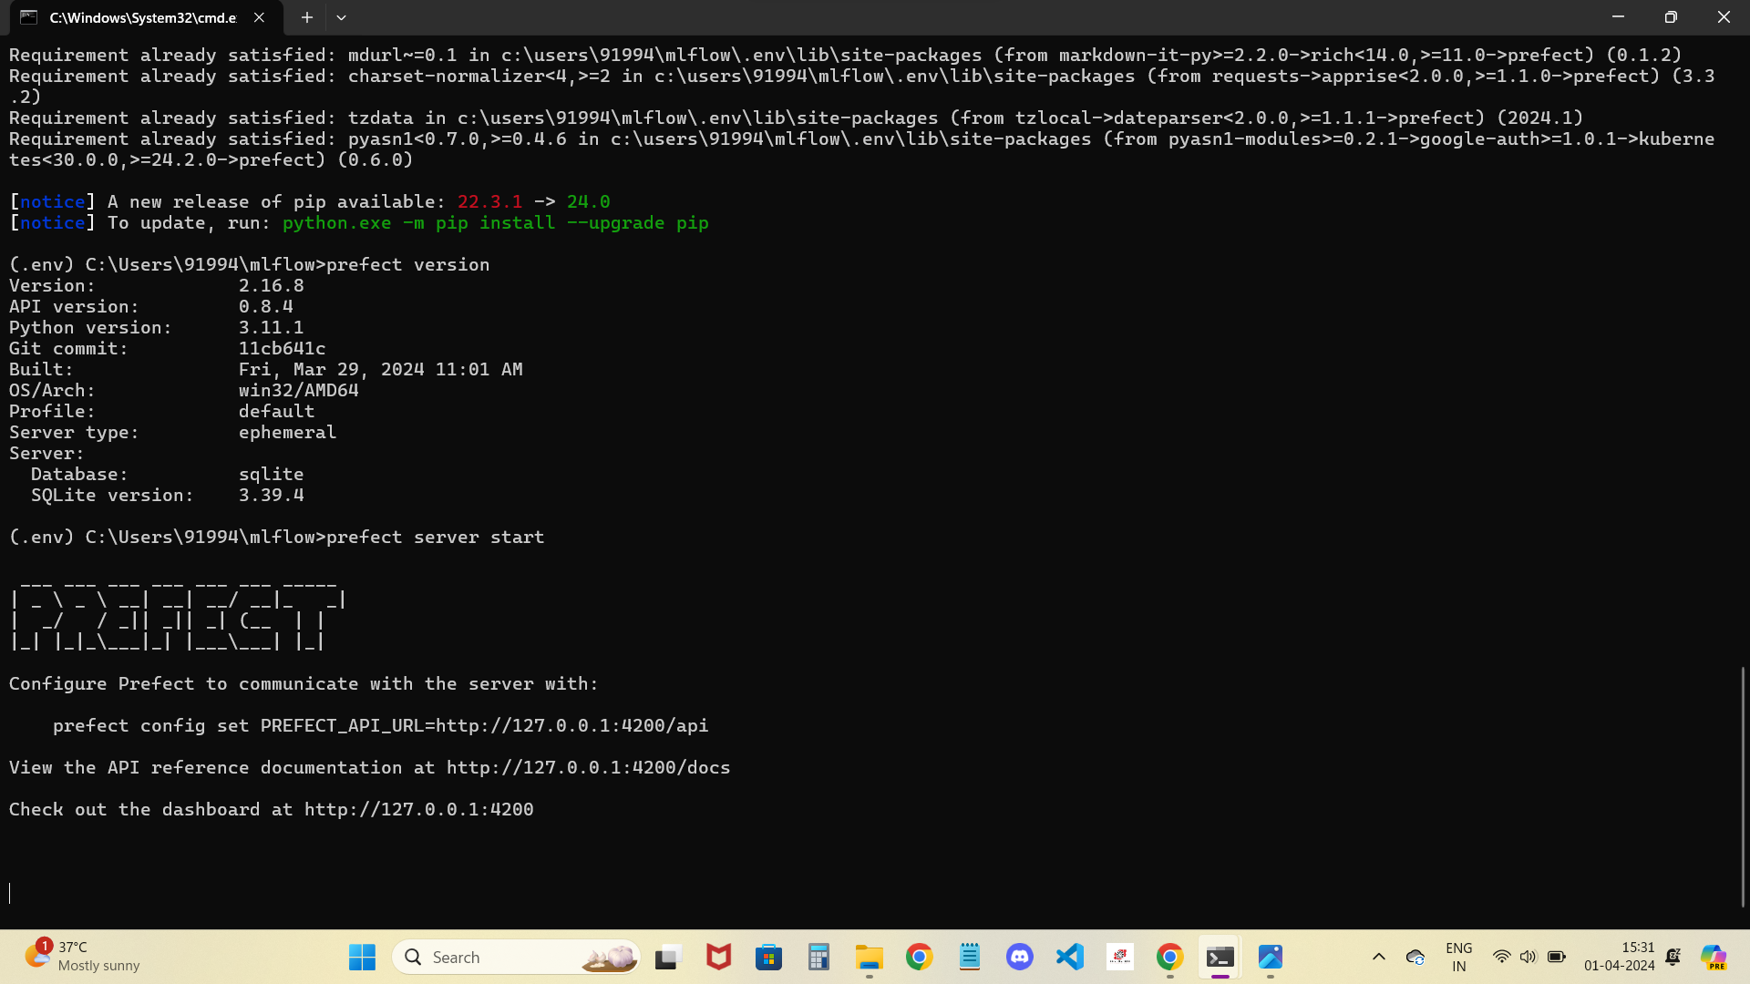
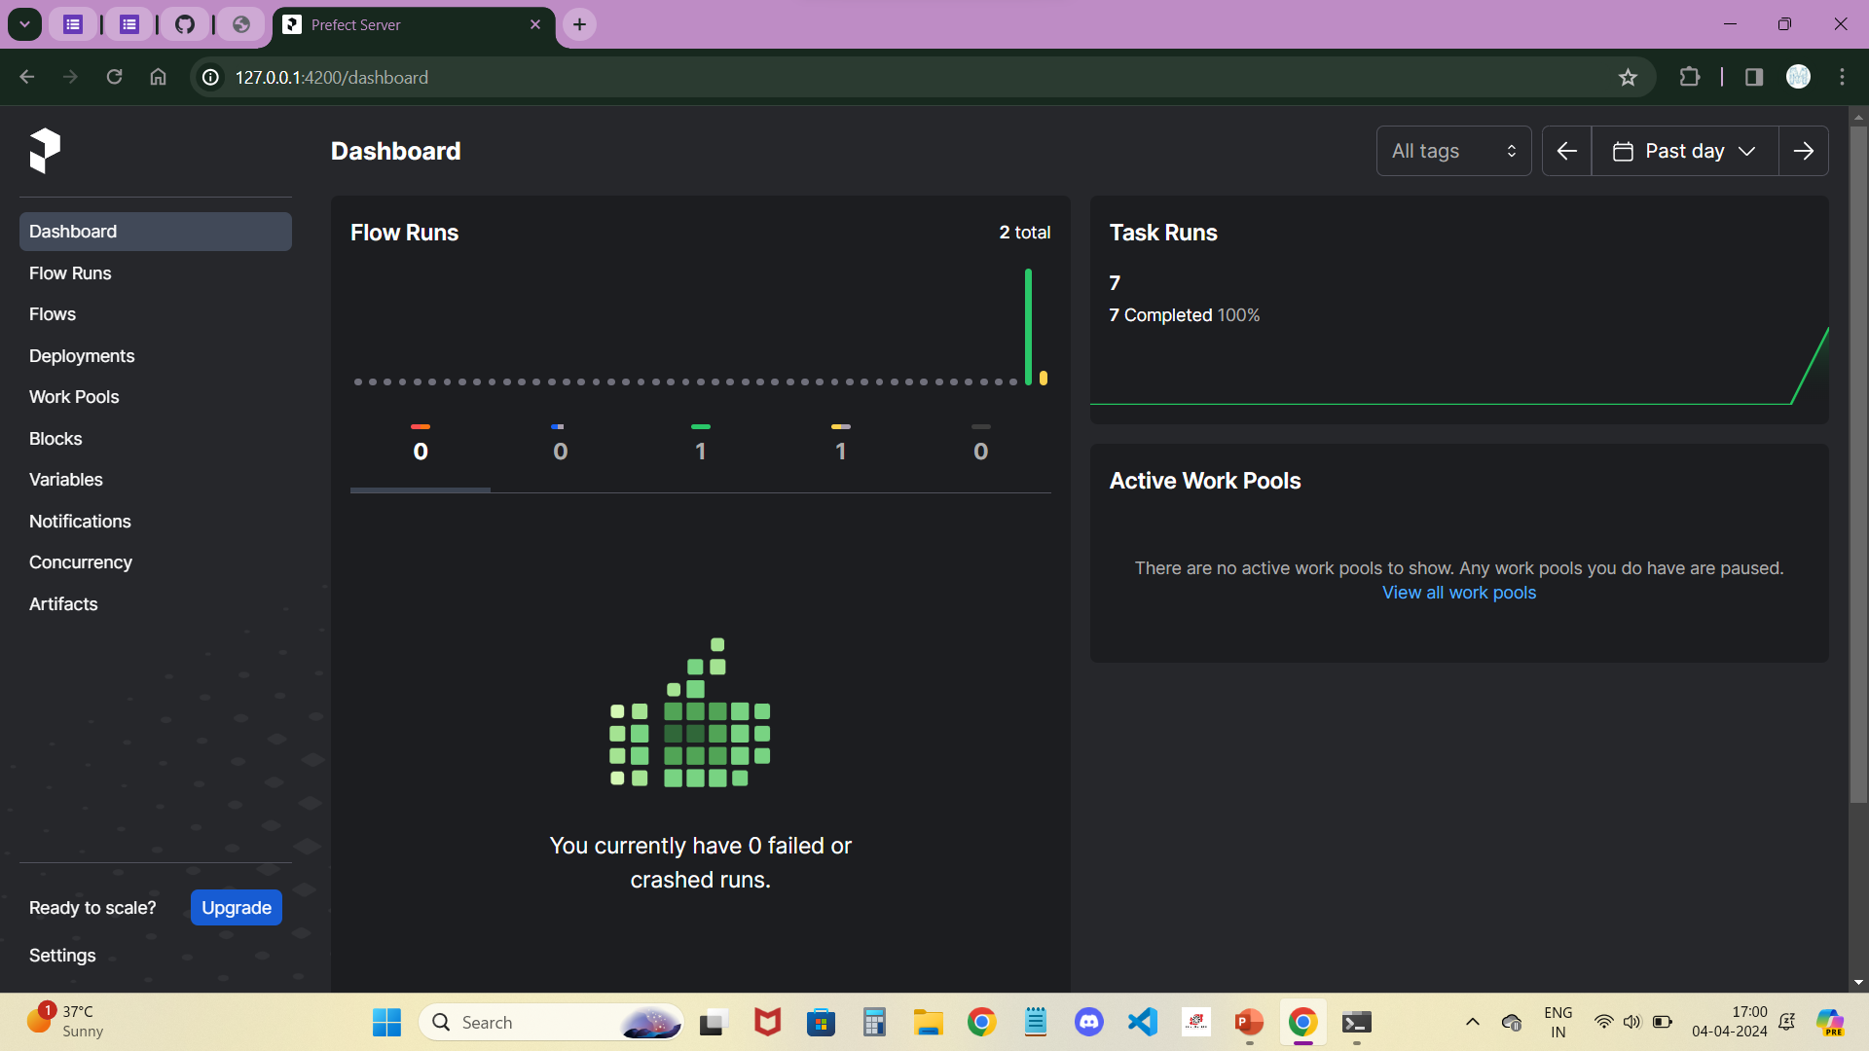
We can check out the dashboard at http://127.0.0.1:4200
This link allows us to access the Prefect dashboard.
Orchestration refers to the coordination and management of various tasks, resources, and processes involved in the end-to-end machine learning lifecycle.
We can refactor our code to use functions, we can run our flows as usual using Prefect's CLI or Python API, and we'll be able to visualize and monitor them in the Prefect dashboard.
Prefect is a workflow management system designed for automating and orchestrating data pipelines and workflows. It offers a Python-based interface that allows users to define complex workflows with dependencies, retries, and error handling. Prefect integrates seamlessly with various data processing tools and cloud platforms, making it suitable for building scalable and reliable data pipelines.

Slide 17
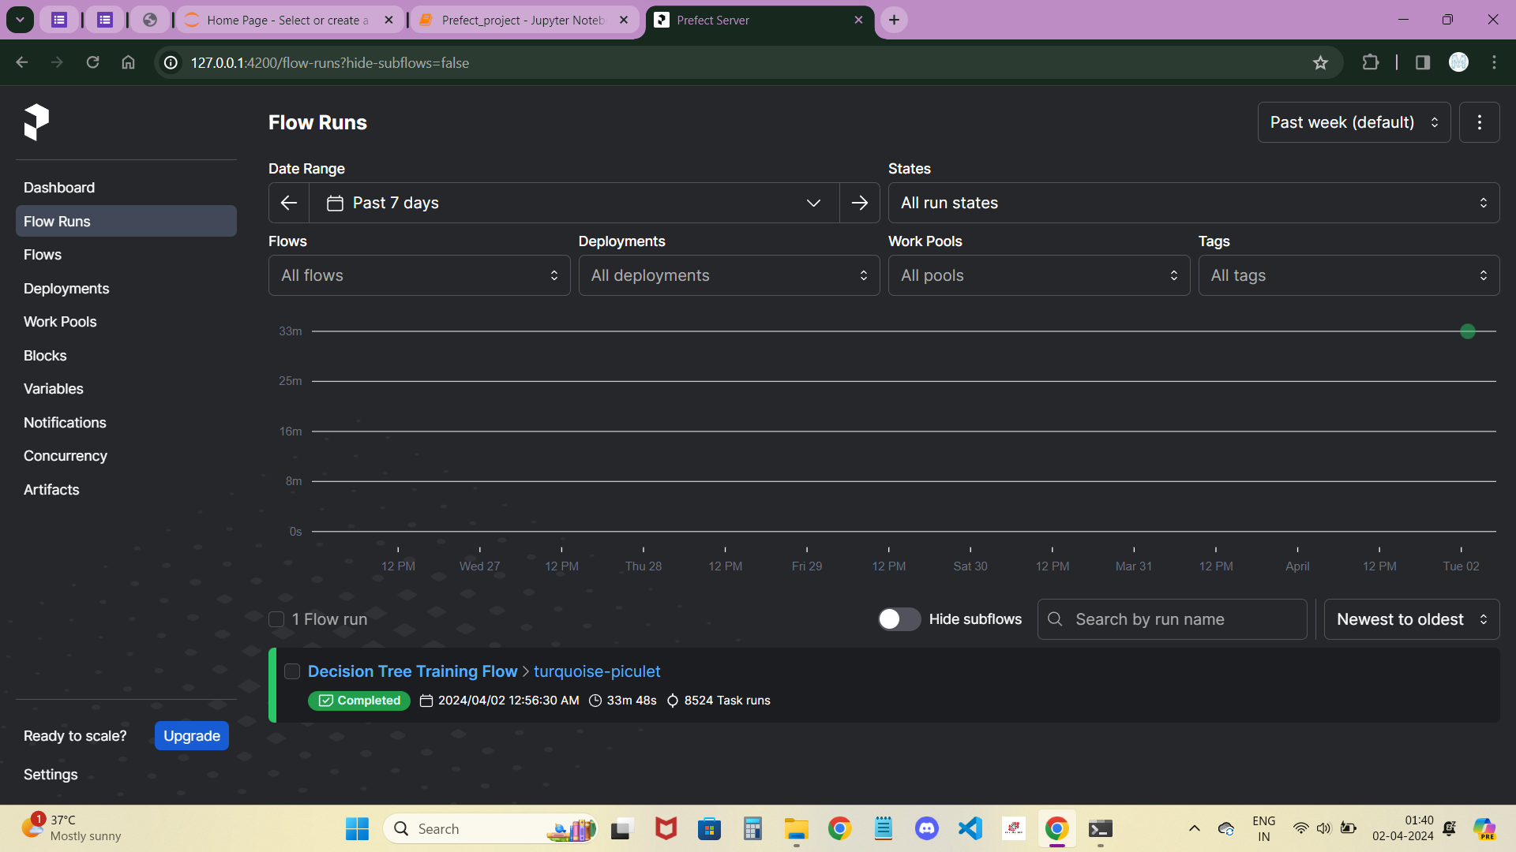
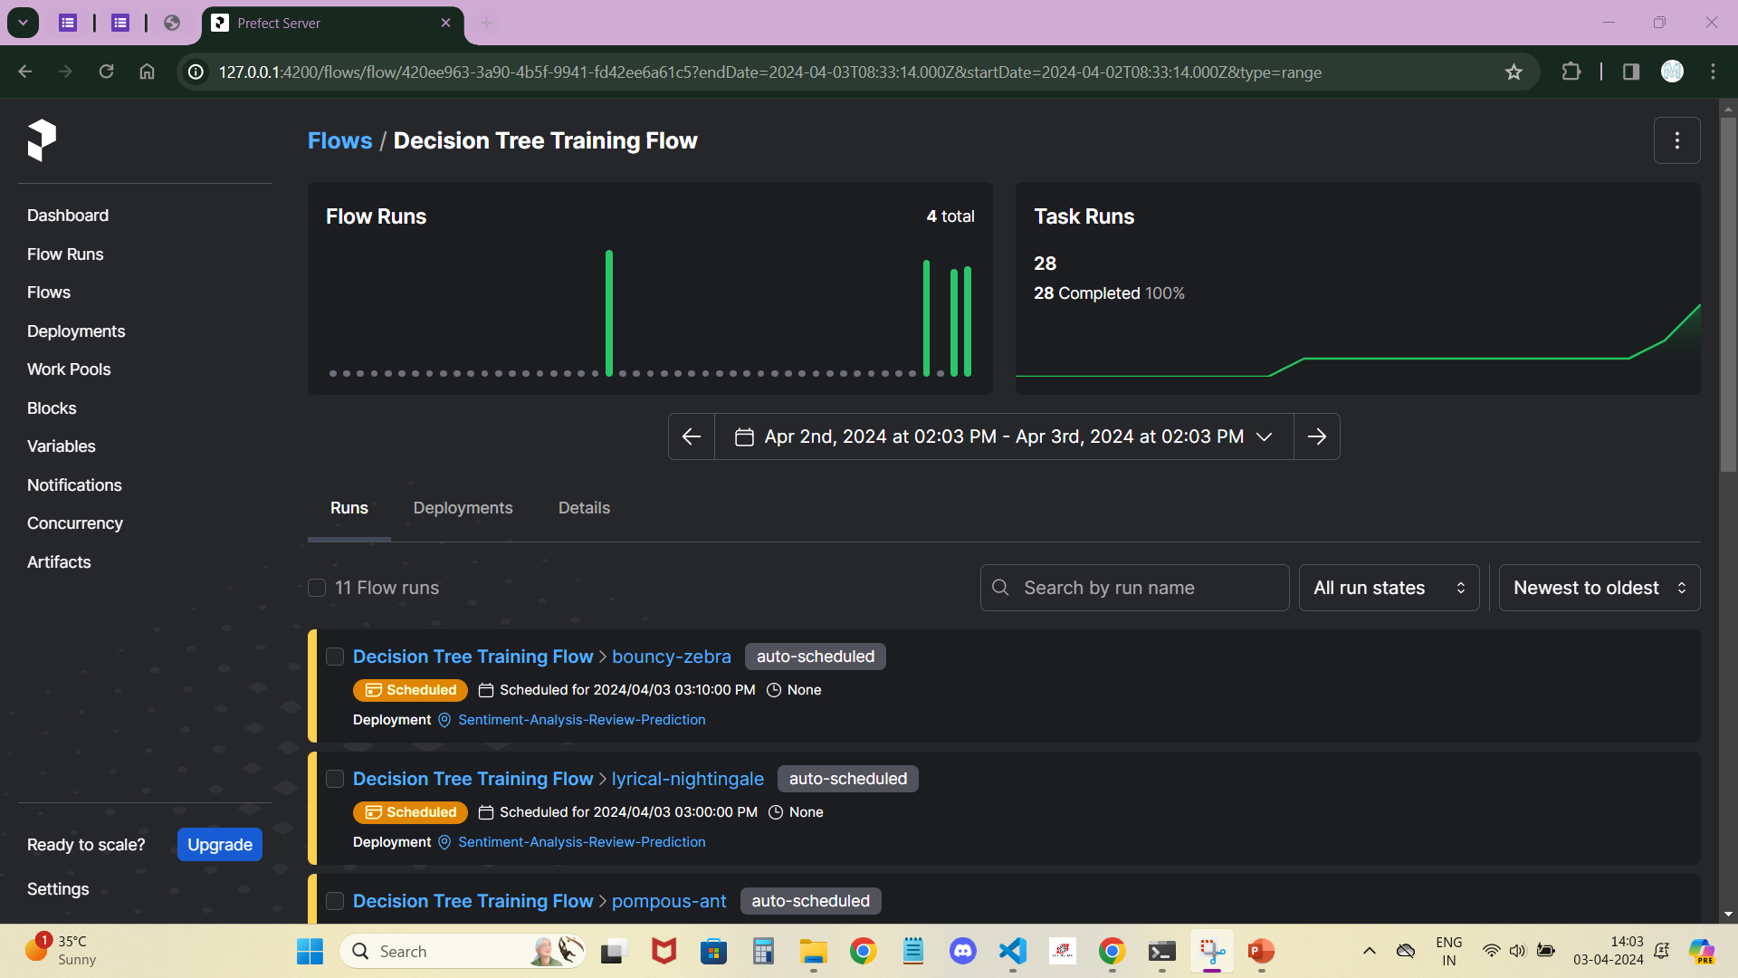
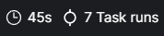
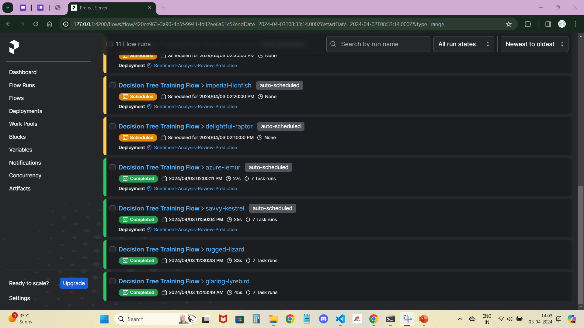
This flow was created without deployment i.e., without cron for scheduling.
It won’t be scheduled cause we didn’t use workflow.serve() or workflow.deploy() instead we use workflow() .
In this case, flow runs will be shown as a Dot (or small circle) same as shown in the beside image.
A list of Prefect runs sorted from newest to oldest. Each run is associated with a Decision Tree Flow and has been auto-scheduled for deployment. The runs are scheduled at specific times, with the latest run scheduled for the future. The 'Completed' runs show the date and time of completion, along with the duration and number of task runs associated with each flow. The runs provide insights into the execution status and performance of the Decision Tree Flow in processing Sentiment Analysis of Flipkart products Reviews prediction tasks.

Slide 18
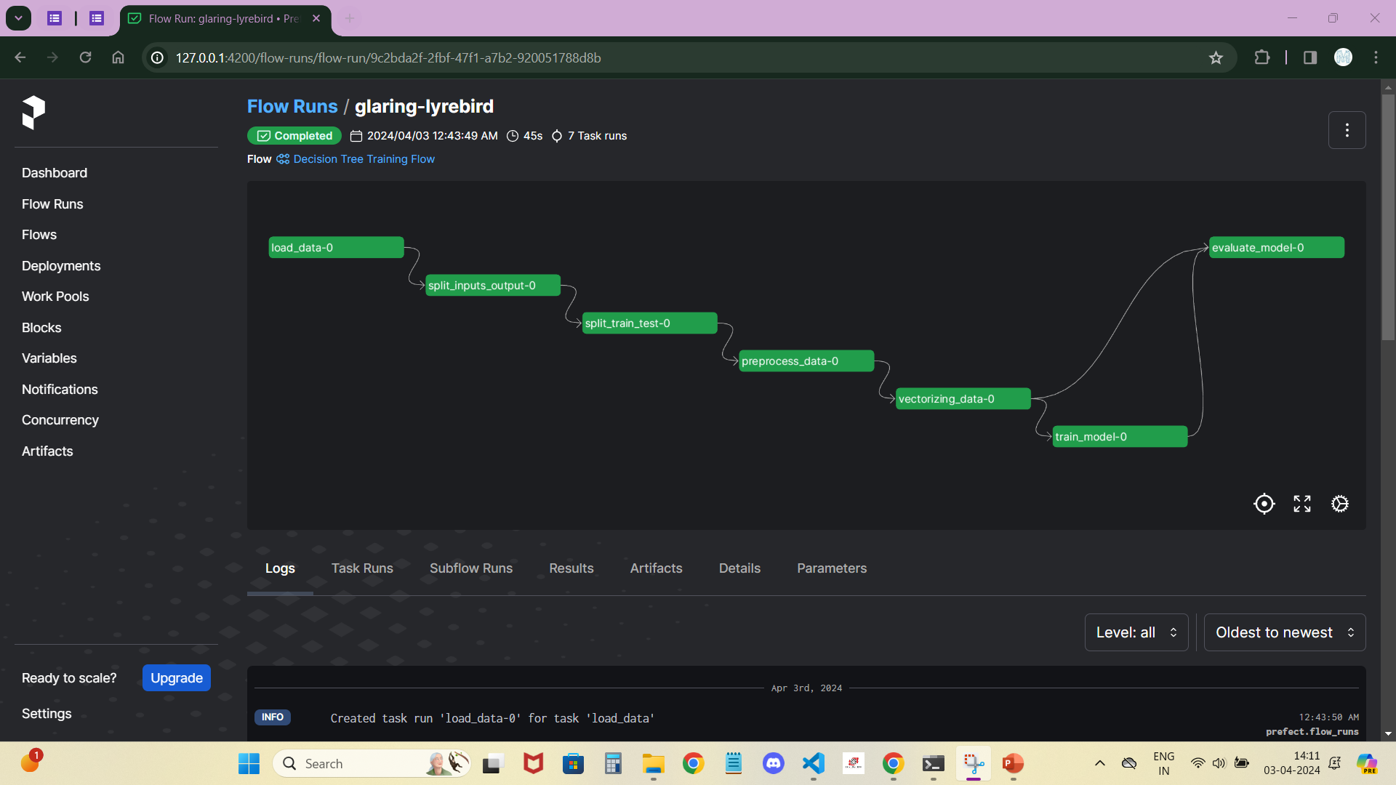
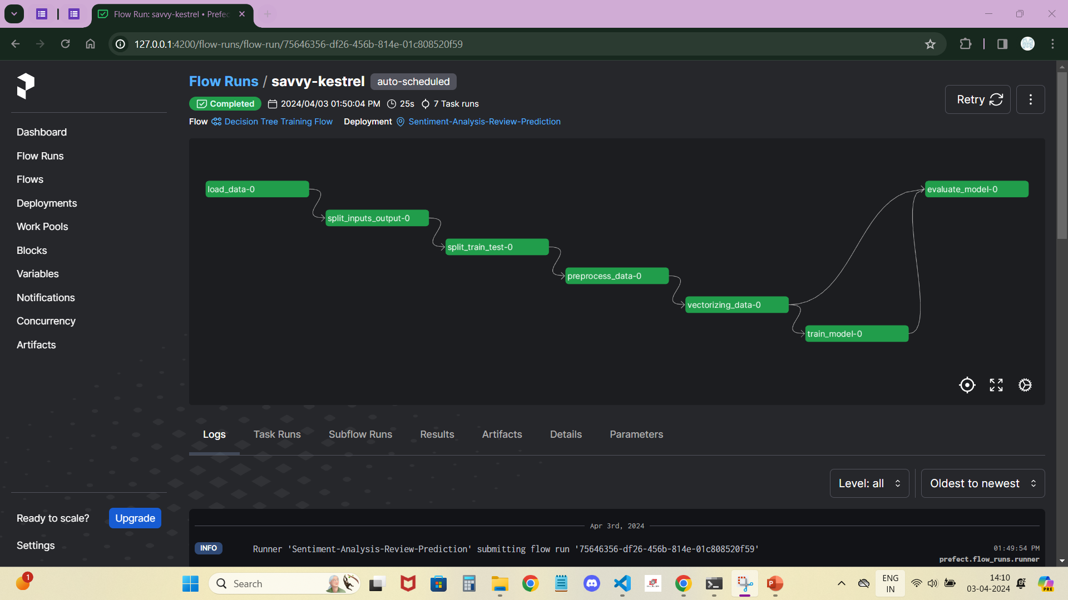
This Workflow was created without using either workflow.serve() or workflow.deploy() .
That’s why, it doesn’t showing the deployment and the registered model beside flow name.
It was not an auto-scheduled flow.
It will only run when we open the Prefect Dashboard.
This Workflow was created with workflow.serve() .
That’s why, it was showing the deployment and the registered model beside flow name.
It was an auto-scheduled flow, which run with a specific time.
That too, when we open the Prefect Dashboard only.

Slide 19


Thank You

